Slide 1
Routines-Based Intervention for Early Childhood Home Visiting
Robin McWilliam
EIEIO
(Evidence-based International Early Intervention Office)
ramcwilliam@ua.edu

Slide 2
Outline
How children learn and how services work
Needs assessment
Service decision making
Support provision
Evaluation of what we’re doing

Slide 3
How Children Learn and How Services Work
A big challenge to the status quo

Slide 4
Who Has How Much Influence on What?
Caregiver Competence & Confidence
Professional Support
Child Outcomes

Slide 5
How Children Learn
The Environment
The Child
Through repeated interactions with the environment, dispersed over time.
Not in massed trials.

Slide 6
Between Visits (Quality Area 2: Inclusion, Engaging the child in natural environments)
Home Visit
Home Visit
Family
Family
Family-Child Interactions
&
Other Learning Opportunities
Child Learning

Slide 7


Slide 8
Goodness of Fit
Abilities & Interests of Child
Demands of the Routine

Slide 9
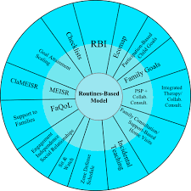
Routines-Based Model

Slide 10


Need Assessment & Planning
Service Model
RBI
Participation-Based Child Goals + Family Goals
PSP or CSP
Ecomap
Caregiver-
Mediated Interventions
FaQoL
Family Confidence
Routines-Based Visits
ECM
Support Provision
Child Goal Attainment + EISR in Routines
Home
Class-room
Clinic
Outcomes
CC2CC

Slide 11

Structure for the Next Sections
Three most important points
Three things not to do
Tools from the RBM

Slide 12
Needs Assessment
What children and their families really need

Slide 13

3 Most Important Points
Informal supports
Meaningful participation in routines
Family needs

Slide 14

Three Things Not to Do
Concentrate on formal supports
Concern yourself with child results on standardized tests
Assume family needs are secondary

Slide 15
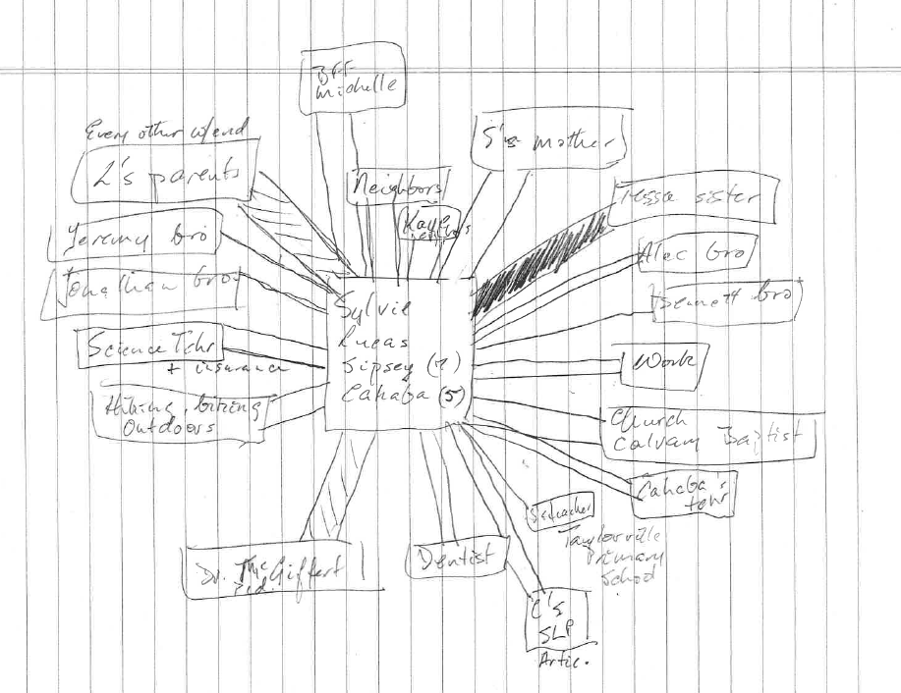
Tools From RBM
Ecomap

Slide 16
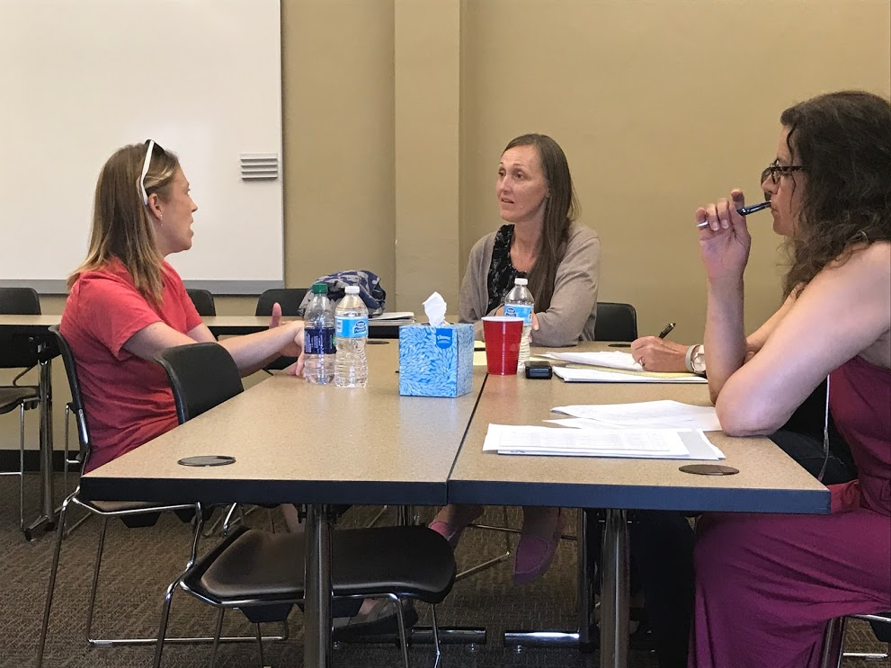
Tools From RBM
RBI— WITH FIDELITY

Slide 17
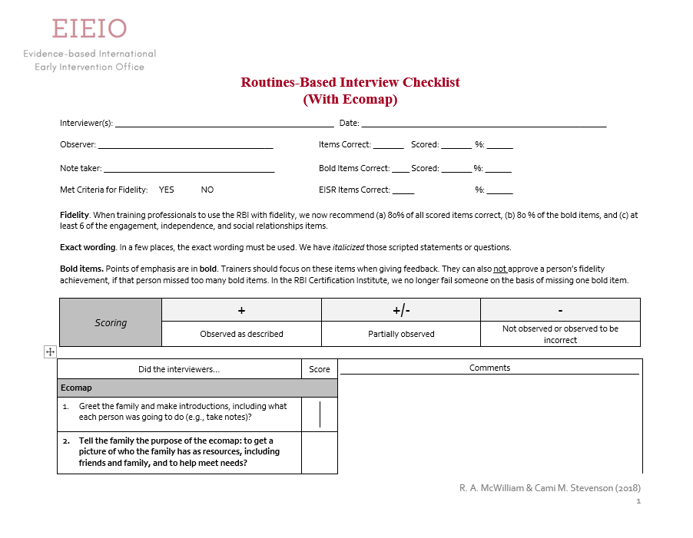
Tools From RBM
RBI Checklist

Slide 18
Service Decision Making
More is not better

Slide 19

3 Most Important Points
One primary or comprehensive service provider
Support family with all child and family needs
Use secondaries as necessary

Slide 20

Three Things Not to Do
Mindlessly pile on services
Restrict yourself to one discipline
Go it alone

Slide 21
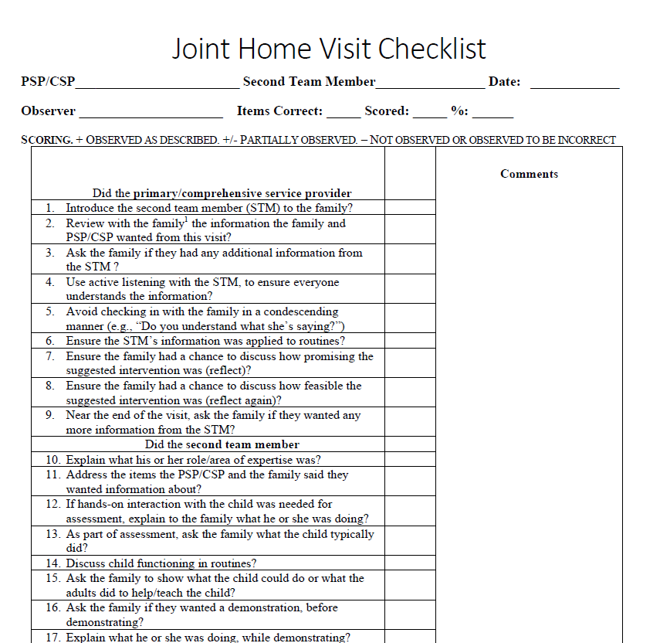
Tools From RBM
Joint Home Visit Checklist

Slide 22
Support Provision
Building capacity

Slide 23

3 Most Important Points
Hoosiers Rule
Incidental teaching in routines
Use informal supports

Slide 24
3 Things Not to Do
Give caregivers recommendations… right away
Work directly with the child—NO TOY BAGS
Pile on services

Slide 25
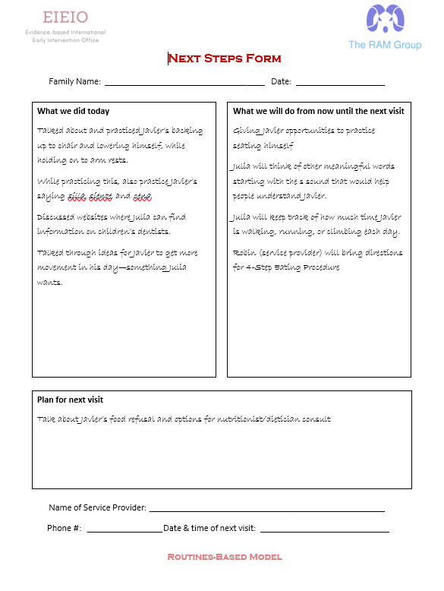
Tools From the RBM
Next-Steps Form

Slide 26
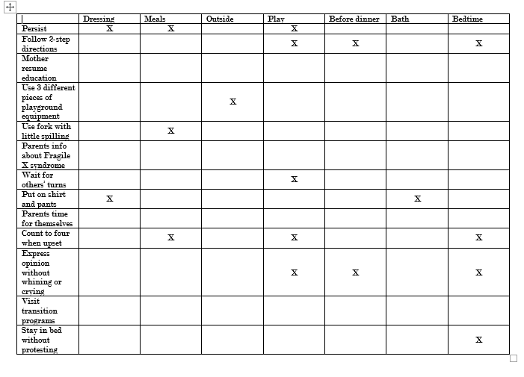
Tools From the RBM
Matrix

Slide 27
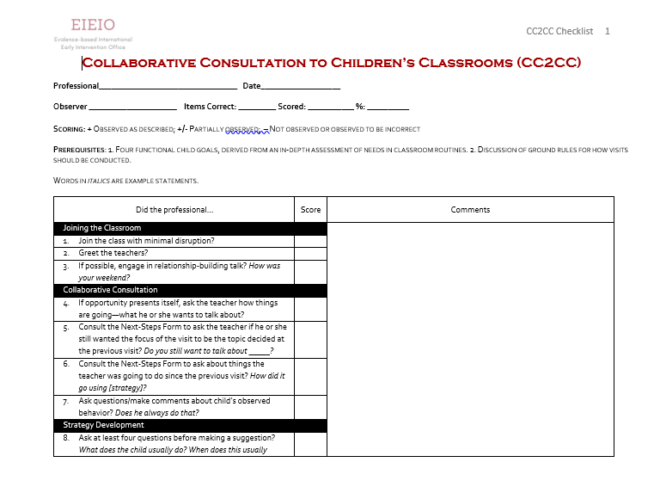
Tools From the RBM
Routines-Home Visit Checklist
CC2CC Checklist

Slide 28
Evaluation of What We’re Doing
Some tools for your tool belt

Slide 29

Proximal Outcomes
Family Confidence

Slide 30

Proximal Child Outcomes
Goal Attainment Scale (GAS)
Therapy Goals Information Form (TGIF)

Slide 31

Distal Family Outcomes
Families in Early Intervention Quality of Life (FEIQoL)

Slide 32

Distal Child Outcomes
Measure of Engagement, Independence, and Social Relationships (MEISR)

Slide 33

Take-Home Messages
Find out what children and their families really need
Give families one comprehensive service provider
Build caregiver capacity
Evaluate your effectiveness

Slide 34
Selected References
Boavida, T., Akers, K., McWilliam, R. A., & Jung, L. A. (2015). Rasch analysis of the Routines- Based Interview Implementation Checklist. Infants & Young Children, 28, 237-247. DOI: 10.1097/IYC.0000000000000041.
Jung, L. A., Bradley, K. D., Sampson, S. O., McWilliam, R. A., & Toland, M. D. (2015). Evaluating construct validity and internal consistency of individualized family service plans. Studies in Educational Evaluation 45, 10-16.
McWilliam, R. A. (2016). Metanoia in early intervention: Transformation to a family-centered approach. Revista Latinoamericana de Educación Inclusiva, 10, 155-173.
McWilliam, R. A. (2016). The routines-based model for supporting speech and language. Logopedia, Foniatría y Audiología, 36, 178-184.
Mas, J. M., Giné, C., & McWilliam, R. A. (2016). The adaptation process of families with children with intellectual disabilities in Catalonia. Infants & Young Children, 29, 4.
García-Grau, P, McWilliam, R. A., Martínez-Rico, G., & Grau-Sevilla, M. D. (2017). Factor structure and internal consistency of a Spanish version of the Family Quality of Life (FaQoL). Applied Research in Quality of Life, 13, 385-398. DOI: 10.1007/s11482-017-9530-y.
Valero, R. F., Serrano, A. M., McWilliam, R. A., & Cañadas, M. (2017). Relación entre empoderamiento familiar y calidad de los servicios de atención temprana (Early intervention quality and family empowerment). Revista de Estudios e Investigación en Psicología y Educación, 11, 317-321.
Morales-Murillo, C. P., McWilliam, R. A., Grau-Sevilla, M. D., & García-Grau, P. (in press). Internal consistency and factor structure of the 3M. Infants & Young Children.
García-Grau, P., McWilliam, R. A., Martínez-Rico, G., & Morales-Murillo, C. P. (2018). Child, family, and early intervention characteristics related to family quality of life in Spain. Journal of Early Intervention. DOI: 0.1177/1053815118803772.
García-Grau, P., Martínez-Rico, G., McWilliam, R. A., & Cañadas M. (in press). Typical and ideal practices in early intervention in Spain during a transformation process of professional practices. Journal of Early Intervention.

Slide 35
Thanks to EIEIO Team
Pau García Grau
Sylvie McDonald
Catalina Morales Murillo
Cami Stevenson
Kimberly Resua Tomeny

