Slide 1


Technical Support to implement reforms to support the development of family centred early childhood intervention services in Greece - ECI Greece
Grant Agreement n° 101048313
PPT 8: Individual Family Service Planning. Design and Implementation

Slide 2



Chapter 4
Individual Family Service Planning. Design and Implementation

Slide 3
Child and Family Individual Service Plan
Is created by the transdisciplinary team, parents are members of the team
IFSP is based on parents’ priorities
Long–term and Short – term functional goals/outcomes are indicated for a child as well as for family
The key to good IFSP is to set individual functional goals

Slide 4
Group discussion
Referred to ECI service: Sandro, 3 years old boy, developmental delay, ASD. Main concerns of the parent: doesn’t talk, is picky eater, problems at kindergarten due to poor self-help skills, he is fully depended on caregivers’ care. Was diagnosed at age of 18 month. Lives with parents and brother 7 years old; attends regular kindergarten.
Write down the ECI service delivery schedule based on
Existed working model / Transdisciplinary team working model / Interdisciplinary team working model
What type of service/services?
How many times per week/per month?
Who are providing the ECI service?
Where is the service delivered?

Slide 5
Example 1. Individual Service Schedule –
In the frame of ECI state program; transdisciplinary teamwork
Sandro, 3 years. Developmental delay, ASD. Entered ECI program at age of 18 months Lives with parents and brother 7 years old, attends regular kindergarten.
Individual Service Plan- March 2018
Early Intervention Specialist 2 X per week – home and kindergarten visits, with the aim to support parent and kindergarten caregivers to improve child self–care and independent functioning, especially during eating time.
Support of ECI specialist by transdisciplinary team members
Occupational Specialist once a month; Speech and language therapist once a month - observation at home and kindergarten, supervision/consultation of ECI specialist
After one year and 6 months of revision IFSP was changed:
ECI specialist 4 times per month
Group sessions at the ECI center – 4 sessions per month

Slide 6
Example 2. Interdisciplinary Teamwork within ECI state program (free of charge) + Private service (paid out of pocket)
Sandro, 3 years. Developmental delay, ASD. Entered ECI program at age of 18 month
Lives with parents and brother 7 years old, attends regular kindergarten.
Individual Service Plan
Early Intervention Specialist 2 X per week – home and kindergarten visits (8 times per month)
Occupational Specialist 2 X per week - Sensory Integration room (8 times per month)
Feeding therapy with speech and language therapist 2 X per week – Center and home (8 times per month)
After 1 year and 6 months, IFSP Plan was changed based on revision
Occupational Specialist 1 session per week - Sensory Integration room (4 times per month)
Speech and language therapy – in pairs - 1 session per week (4 times per month)
Group sessions – 1 session per week (4 times per month)

Slide 7
Example 3. Interdisciplinary Teamwork within ECI state program (free of charge) + State Rehabilitation Program (free of charge)
Individual Service Plan
Early Intervention Specialist 2 X per week – home visits, kindergarten visits (8 times per month)
Rehabilitation Center – Plan is created by child Neurologist
Physical therapist 10 hours once in 3 months – under supervision of OT
Speech and Language therapist 10 hours in 3 month

Slide 8

Three Key Steps
Gather information
Listen for family needs, concerns, priorities
Child’s personal characteristics
Document quality statements
Discipline-free
Third word rule
Observe family/child
Ecological assessment
Jargon-free
Parents determine when/how the outcome is met
Special occasion, life event
Key concept, skill desired: action
Words to avoid
Tolerate, stop, not, often, maintain, therapy, receive, improve
Home safety and hygiene
Across settings, people, times
Preserve as much of parents’ wording as is appropriate
Notes:
In developing IFSP plans, there are 3 key steps.
First, it’s critical to start with the parent’s/caregiver’s priorities about what they hope for the child and family and what’s most important or meaningful to them. Special focus should be placed on their desires related to participation in family and community activities. Using focused open-ended questions can help parents and other care providers reflect on how they want the child to participate in activities and routines that are meaningful to them and what factors impact their child’s successful participation. It is these family priorities, not the practitioner’s or teacher’s priorities, that should serve as the basis for a high quality, participation-based outcomes and goals.
Second, it’s also important to consider what’s working and what’s challenging at home, in the community, and in the classroom. Make note of those situations that are motivating and interesting to the child and family and those that impact participation in family and community life. Asking parents what the child enjoys doing and what they enjoy doing together helps to clarify the context where the child is learning and participating. Similarly, asking parents which parts of their day are not going well provides an understanding of what the parents would like to see different in the future.
For the this second step it is very important the information that has been gathered from evaluation and assessment. The professional must incorporate what has been learned during the evaluation and functional assessment process about the child’s developmental skills, needs and disability and their impact on the child’s learning and participation.
The 3rd step is related with the quality of the document produced that should meet certain specific characteristics.
All 3 steps are critical for developing quality outcome and goal statements, as well as informing decisions about strategies and activities that will most effectively promote incidental learning and the opportunity to practice new skills to meet outcomes and goals.

Slide 9
Functional Goals answer 5 key questions:
Who? What? Where? With whom? When?
Long term goals should lead to outcomes in three main areas of child functioning
Communication
Personal Independence
Positive Social Interactions
Short-term goals promote the acquisition of such functional skills which lead to the fulfillment of the long-term goals

Slide 10
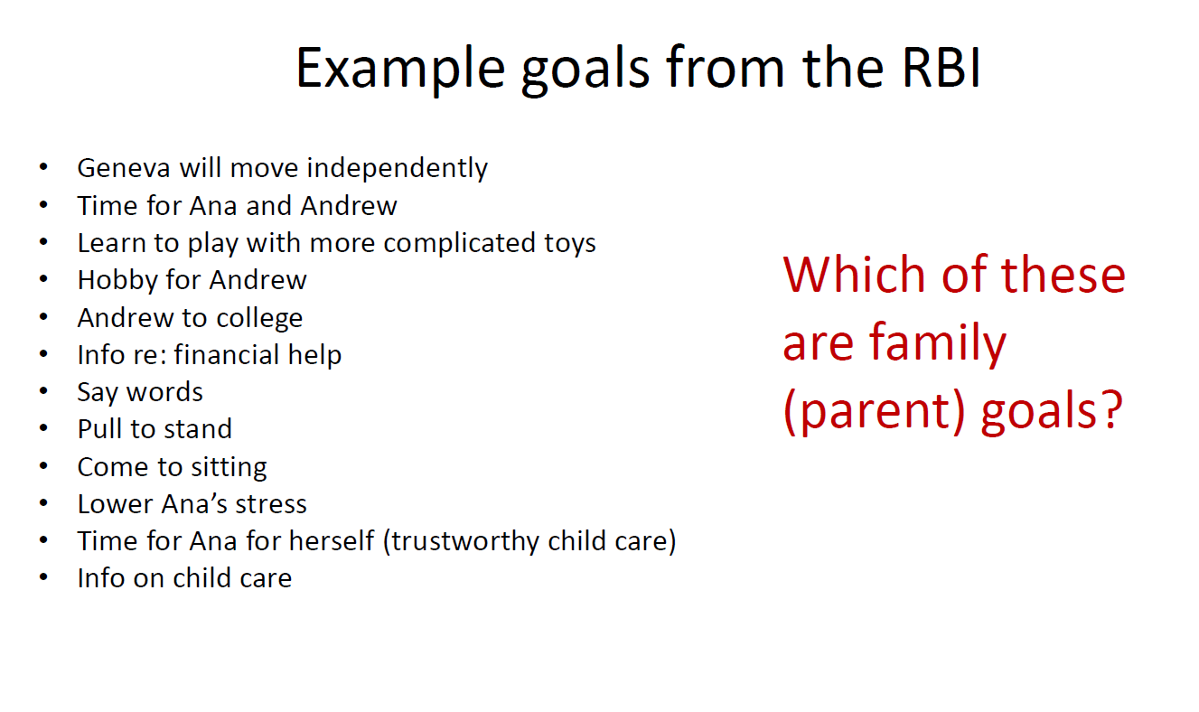

Slide 11
Outcomes
Everyday life centered & Child-centered
Participation oriented
Related to child learning within the context of everyday learning opportunities
Builds on interests of child/family
Indicate active involvement of child
_____________________________
Family worded
Positive
Action-oriented
Indicate changes

Slide 12
IFSP Child Outcomes
Two types of child outcomes:
Participation-based
Routine/activity-based
Child outcomes should:
Enhance learning through functional participation in everyday activities (child is learner/actor)
Be important and meaningful to the family/caregiver (priorities)
Expand activity settings so child can be competent
Be based on child’s interests
Notes:
Often, IFSP child outcome statements are participation-based, focusing on the child’s interests and assets that will provide opportunities for learning and development. Other times, IFSP outcome statements focus on the routines and activities that parents want or need to go more smoothly, such as mealtimes or bedtime routines.
Child Outcomes should:
Enhance the child’s learning through functional participation in everyday activities (child is learner/actor),
Be important and meaningful to the family/caregiver (their priorities),
Expand activity settings in which the child can be competent, and
Be based on the child’s interests.

Slide 13
IFSP Family Outcomes
Two types of family outcomes:
Participation-based
Resource-based
Family outcomes should:
Enhance capacity of (family is learner/actor)
Support accessing community resources and supports (service coordinator supported)
Be important and meaningful to the family/caregiver (priorities)
Be based on family’s interests
Notes:
There are two types of family outcomes – participation-based or resource based outcomes.
Family Outcomes should:
Enhance the capacity of the family to meet the needs of their child (family is learner/actor),
Support accessing community resources and supports (service coordinator supported),
Be important and meaningful to the family/caregiver (priorities), and
Be based on the family’s interests.
An example of a participation-based family outcome is:
“Frank and Tamara would like to be comfortable taking Dawn with her siblings to their grandmother’s house.”
An example of a resource-based family outcome is:
“Jeri will find child care for her son within 25 miles of her new job.”

Slide 14
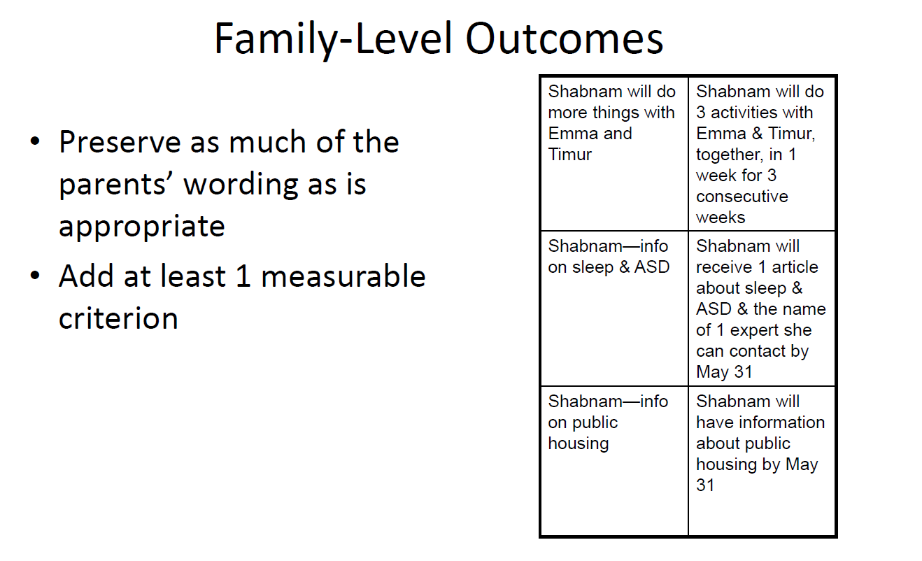
Notes:
IFSP outcomes are equivalent to asking a family: “What would your family like to see happen for your child?”

Slide 15
Necessary Functional | 3rd Word Rule- Action | Jargon-Free
Discipline-Free | OUTCOME | Emphasize the Positive
Reflects Real Life | Context Family Concerns Family Priorities Strengths-Based | Avoid Passive Words (tolerate, maintain, receive, improve)
Notes:
Another approach is to use the “third word” rule, identified by Rush and Shelden. The third word rule refers to the third word in the outcome statement. As a test of whether the outcome statement is participation based, examine the third word for an action that is functional for the child. The word “eat” in the example of Kim used in the slide meets the criteria.
Another example of an outcome statement with a functional third word is “Thomas will ask for food he wants during meal times.” In contrast, “Thomas will say three words when asked to repeat them” is skill-based and does not provide context for learning and engagement.
The ISFP should be jargon-free, clear and simple. This means that the outcome is written so that is understandable by the family and the general public, and does not include professional jargon or practitioner “speak.”. For example, the outcome should describe how the child will move, such as reaching up or down for toys, instead of using phrases like “range of motion.”. Another example would be wording an outcome so that it describes a child able to use words clearly to make herself understood, rather than using the term “articulation”.

Slide 16
Functional?
Meaningful? Child? Family?
Lily will go fishing with her grandfather and hold the fishing pole
Jennifer will eat her meals with her family while sitting in her highchair
Myka will play with the puppy by throwing the ball while being held by his father
Lili and Pat will put Mike to bed for naps and bedtime
Leka will sit in the bathtub during bath time
Eka will walk to the mailbox to get the mail every afternoon
Be specific with activity
Be direct
Ask: What does the family want the child to do and when?
IFSP outcome is a benchmark representing what we would like to happen
Don’t forget: third word rule

Slide 17
Child Outcome: Example
This
Not This
“John will improve muscle tone for sitting.”
“John will play with toys and eat meals with his family by sitting without much support.”
Notes:
From this priority shared by John’s parents, here is an example of a high quality IFSP child outcome statement in comparison to a statement that is not high quality:
High quality:
“John will play with toys and eat meals with his family by sitting without much support.”
Not high quality:
“John will improve muscle tone for sitting." Based on the criteria of high quality outcomes that were just reviewed, do you have any ideas as to why this is not high quality? (Answer - not jargon-free, uses passive word.)

Slide 18
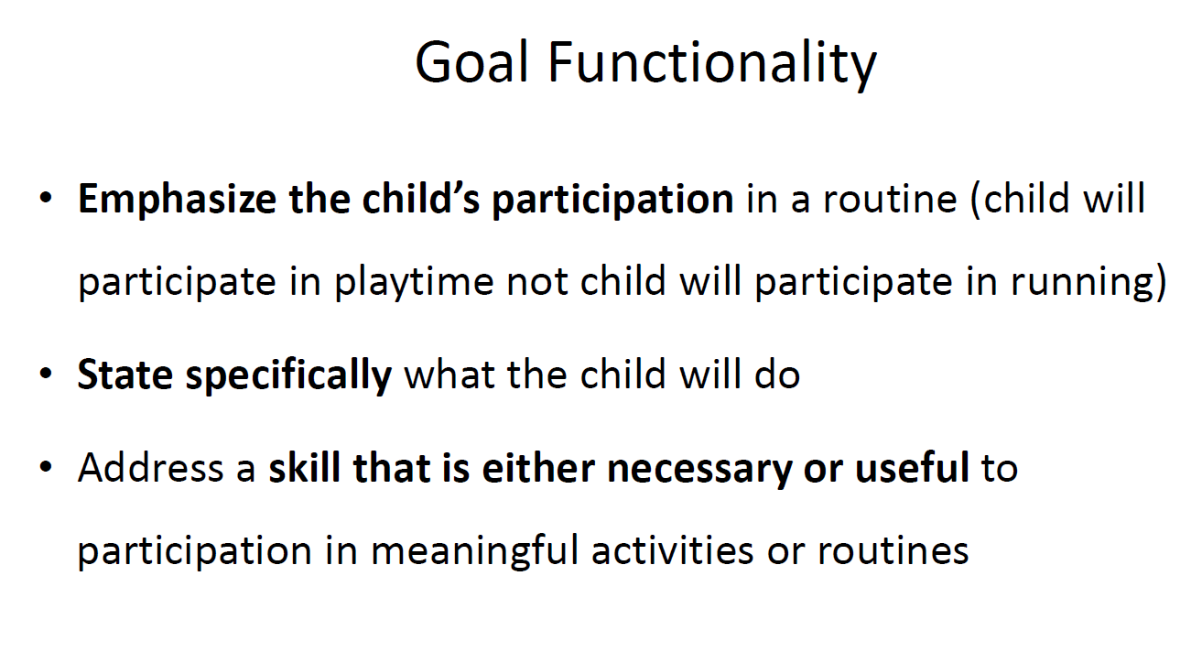

Slide 19
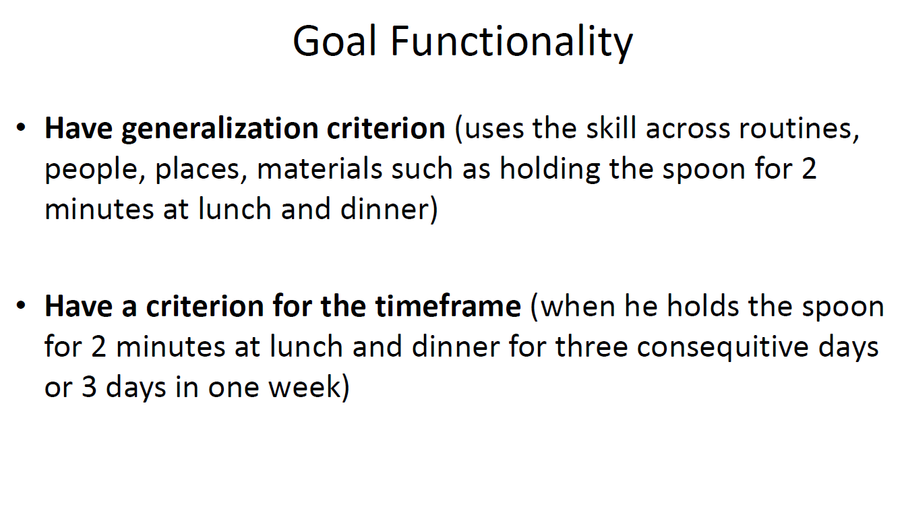

Slide 20
Step 1: Determine the functional area(s) | Eating
Step 2: What routine(s) does this affect? | Meal time with the family
Step 3: Child will participate in [routines in question] | “John will eat with her Family at mealtime…”
Step 4: “by ________ing” (address specific behaviors) | “…eating the foods they eat.”
McWilliam, R.A. (2006). Steps to build a functional outcome.
Notes:
The 4 step process on this slide reflects the development of the IFSP outcome statement to ensure that the core portion of the statement is written functionally and is participation-based. These steps were adapted from a 7 step process that includes criteria, procedures and timelines developed by Robin McWilliam.
Let’s walk through the example we’ve developed using this 4 step sequence.
First, based upon the parent’s/caregiver’s priorities, determine the functional area that the outcome relates to. In our example, we selected “eating.”
Second, determine the routines affected. We selected “meal time with the family.”
Third, develop a statement that reflects how the child will participate in the routines, such as “John will eat with her family at mealtime . . .”
Finally, add to the initial part of the outcome statement developed in Step 3, what the child will do (defining specific behaviors). “. . . eating the foods they eat.”
So the complete outcome statement that we developed using this framework is: “John will eat with his family at mealtime eating the foods they eat.”

Slide 21
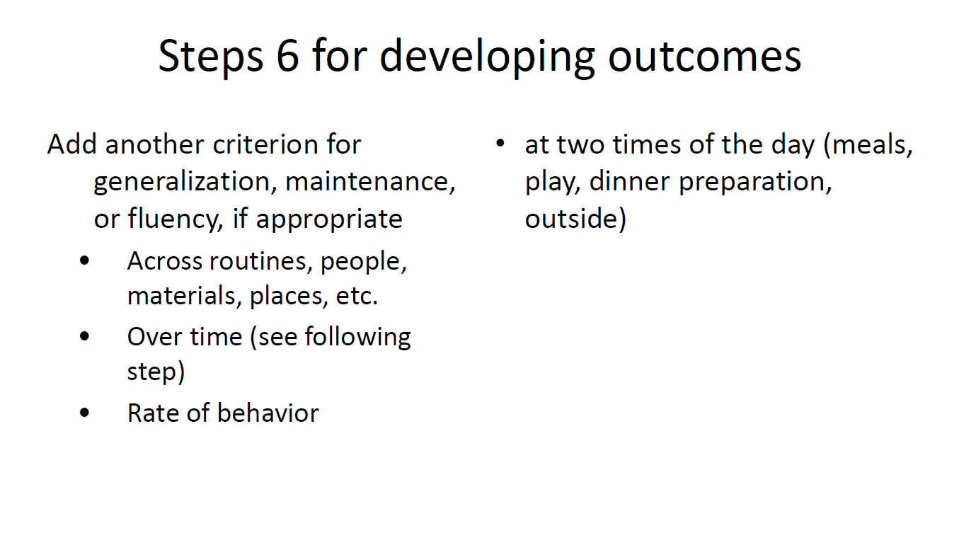

Slide 22
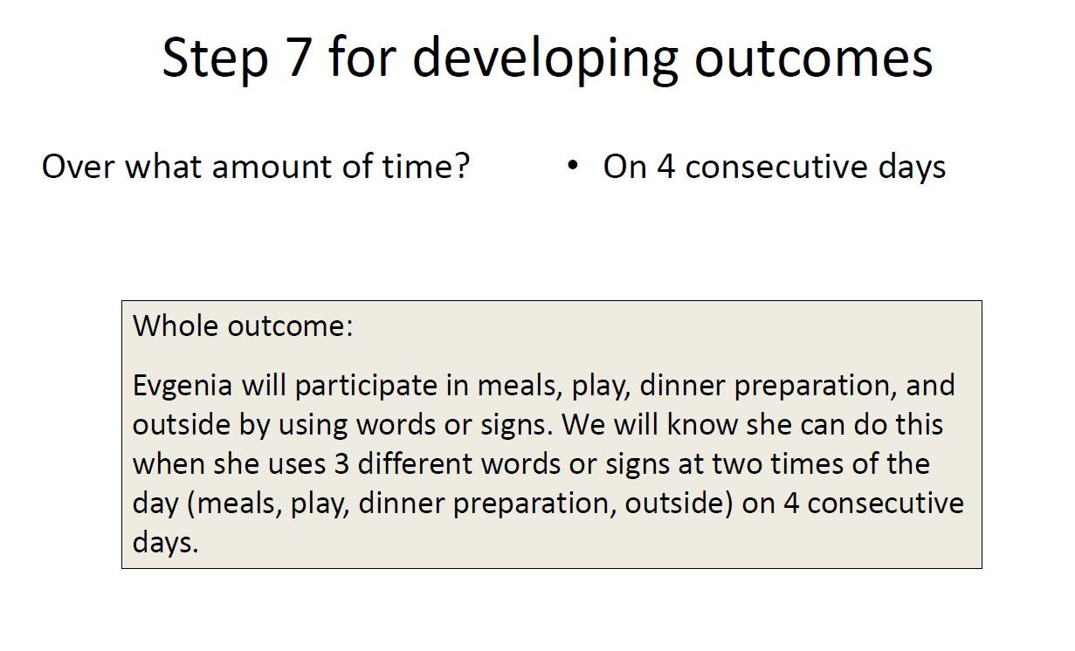

Slide 23
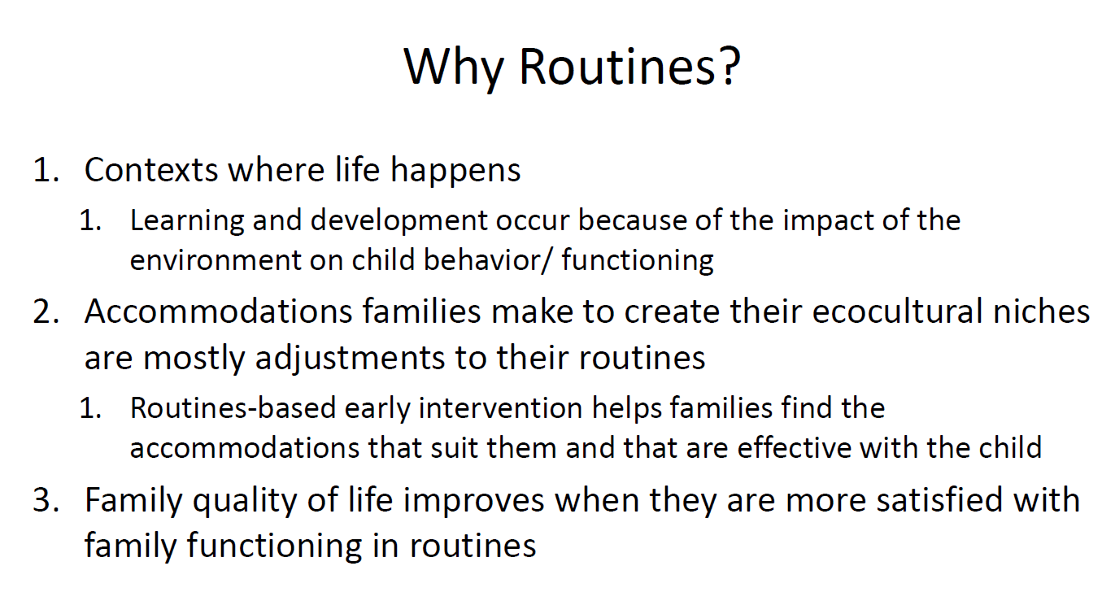

Slide 24
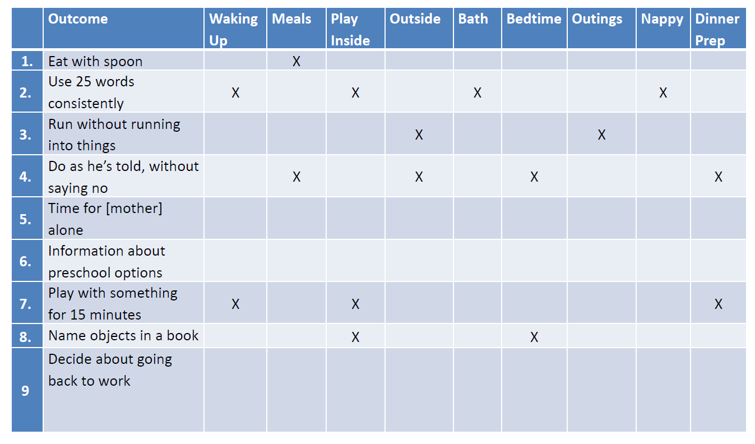
Intervention Matrix

Slide 25
Important!
Stage 5. Service Delivery
All interventions occur between visits
We are building family capacity
We promote children’s functioning, engagement, and participation
We follow the service structure, at the same time are flexible in responding to families’ current needs

Slide 26
Structure of the Home Visit
Beginning of the session
EI specialist asks parent/caregiver questions how the week has passed, what interaction with child looked like, how they rehearsed the skills which were demonstrated during last visits
2. Activities with Caregiver and Child
Observing Child -Caregiver interaction - how caregiver works with the child within specific functional activities
EI Specialist asks reflective questions to the caregiver about just demonstrated activities
Introduction of new ideas of working with child by EI specialist to caregiver and demonstration of specific techniques of working with a child
3. Summing up the session - Planning next visit, giving homework to caregiver

Slide 27
Home visiting Process
1. Ask caregiver what has happened since the last visit
2. Observe child-caregiver interaction and give feedback
3. Offering new strategies and working on new skills
4. Planning next visit, agree upon what the will caregiver work together with the child on between visits
5. Sum up the visit

Slide 28
Transition to Kindergarten
Discussion with Family
Plan to visit kindergarten
Make collaboration
Planning of Transition process
Support of child, parents and the new team

Slide 29
Progress Monitoring
Individual Goal’s Monitoring
How goals are implemented
The aim is to modify /change the goal or take a new one
Every 3-6 Months
Annual Re-assessment
Child and family Reassessment
Service Plan Revision
Change Goals
Change key specialist
Revision of duration/frequency of the program

Slide 30
Program Evaluation
Parent Satisfaction
Staff members’ evaluation and satisfaction
  Self–evaluation
  Peers Evaluation
Evaluation of program administration process
Databases

Slide 31
Training and Supervision of ECI Specialists
ECI Philosophy and principles
Case management
Standards and Administration rules
Pre-service training requirements

Slide 32
Certificate Training Course for service providers
Provided by ECI Coalition
Module 1 Philosophy and principles
4 Modules
Module 2
Assessment of Children and Families
Theoretical training -125 hours, 50 hours practice
Module 4 Standards, program administration
Exam, certification
Module 3
IP Planning/ Intervention
6-month professional supervision
Exam

Slide 33
Supervision
Supervisor – (3 years Experience In ECI, MA Diploma, Supervisor’s Certificate)
Who gets supervision – all staff members with different intensity of individual supervision, Peer and group supervision /training once a week
Types of Supervision
Reflective – regarding working with child and parents/teachers
Organizational – about administrative Procedures
During Session
After Session (Individual)
In Large and small groups

Slide 34
ECI State Service Standards
For children and parents
Awareness
For specialists
Feedback regarding the quality of service provision
For State agencies
Existence of service standard procedures and documents
Active engagement within service provision process
Child involvement in general education system
Professional satisfaction and prevention from overwork and exhaustion
Opportunity to implement monitoring of the services
Protection of child and family interests and rights

Slide 35
Early Childhood Intervention service standards
9 Article
Information about the service and beneficiaries
Ratio of specialists and beneficiaries
Protection of confidentiality
Protection from violence
Using basic principles of intervention and individual approach
Feedback and complaint procedures
Requirements towards personnel
Termination of service provision
Equal access to service, family involvement, and inclusivity

Slide 36




European Association of Service providers
for Persons with Disabilities
Thank you!

