Slide 1


Technical Support to implement reforms to support the development of family centred early childhood intervention services in Greece - ECI Greece
Grant Agreement n° 101048313
PPT 7: Early Childhood Intervention Country models

Slide 2



Chapter 3
ECI Service Planning and Implementation – Family and Child Evaluation

Slide 3
First meeting with family
Parents share their expectations with ECI specialists regarding ECI service
ECI specialist gives detailed information about terms of the service provision and responsibilities of both parts, hands-on an informational brochure and asks for an introduction to other family members as well
ECI specialist receives the final confirmation that the family is ready to participate in ECI service and follow the terms of the service
An formal, written informed consent/agreement is signed
Main caregiver and ECI specialist agree on the service schedule: when, how many times, with whom and where the intervention should be delivered (in kindergarten, at home, or in both places)
Notes:
1. Reflection on what parents know about the service, their expectations, and what kind of service they are expacting, what kind service they need.
2. ECI specialist confirms and/or verifies information about the service received from the parents and provides additional information
3. Demonstrates an informational brochure, and hands it over to the parents for detailed observation and introduction to other family members as well
ECI specialist receives the final confirmation from the parent. If family don’t like the terms and condition of the ECI service and thay have right to refuse to get the service
In case of refusal it should be discussed with the supervisor and servie coordinator to decide on further actions (ECI service provider organization has to notify the State Social Agency and discuss further steps. State Social Agency can cancel the service if the consensus is not met with the family).
If agreement is achieved with the family and informed consent is signed, from the next visit attendance of main caregiver is required (mother, father, grandparent, nanny, kindergarten's caregiver); this condition must be agreed upon in advance meeting or by phone.
Main caregiver and ECI specialist agree the service schedule: when, how many times, with whom and where the intervention should be delivered (in kindergarten, at home, or in both places);
An formal, written informed conscnt/agreement is signed;

Slide 4
Step 2 - Child and Family evaluation by Inter/transdisciplinary team of ECI provider organizations
Family Assessment | Child Assessment
Family demographic information Ecomap Family day routine Positive parenting skills’ self-assessment Home Safety and hygiene | Child personality profile Child development assessment Child specific assessment by different professionals if needed Challenging behavior assessment (if needed)

Slide 5
Competences of ECI specialist needed for conducting a child – family evaluation
Child age 0 – 30 month | Assessment areas | An environment where assessment is conducted | ECI specialists’ competencies and training
Child development | Developmental Assessment: Communication Motor (Gross, fine) Social-emotional Problem-solving Adaptive | Home, place where child lives, natural context | Pre-service training of ECI specialists to use of curriculum-based developmental assessment Ongoing professional supervision
Family Environment | Family demography Ecomap Family day routine Positive parenting skills’ self-assessment Home Safety and hygiene | The home, place where the child lives, natural context | Pre-service training of ECI specialists in using the tools for assessment family and environment Ongoing professional supervision

Slide 6
Competences of ECI specialist needed for conducting a child – family evaluation
Child age 36 – 60 month | Assessment areas | An environment where assessment is conducted | ECI specialists’ competencies
Child development | Developmental Assessment: 36 – 60 month children developmental assessment Preschool academic skills School readiness | Home ECI center – group work sessions Kindergarten | ECI specialist - developmental assessment Psychologist - Preschool academic skills and school readiness OT or Speech therapist might be need
Family and Educational setting (kindergarten, school) environment | In case a child is in service for the first-year family environment should be assessed Kindergarten environment and child-caregiver interaction Child’s engagement in-class activities | Home ECI center – group work sessions Kindergarten | Trained ECI specialist OT or Speech therapist might be needed

Slide 7
Specialization of Transdisciplinary team members
Psychologist – cognitive and psycho-emotional development, challenging behavior
Occupational Therapist - functional skills, motor development, an adaptation of environment, sensory integration, assistive technology
Speech and Language Therapist – verbal, nonverbal, and/or alternative communication
Pediatrician – monitoring of health status of a child, special diet, referral to health institutions of the children
Social Worker – identification of family needs and mobilization of community recourses (it happened at the state level, that’s why ECI service providers don’t have SW in the internal team)
ECI specialist - implementation of Individual Family Service Plan and working with parents and other family members in order to stimulate child’s holistic and functional development; Plan and support of transition process in kindergarten, support adaptation and engagement in-class activities.

Slide 8
Biopsychosocial Assessment
Child
Biological Factors
Psychological factors
Social factors
Gender
Physical Health
Mental health
Genetics
Immune system
Stress comping Medicaments
Social protection
Family history
Culture
Traditions
Economics
Available education
Personal characteristics
Attitudes/beliefs
Emotions
Cognitive/Intellectual abilities
Behavior
Coping Mechanisms
Past experience

Slide 9

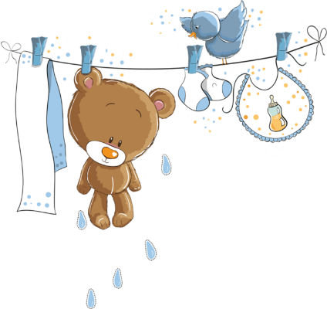
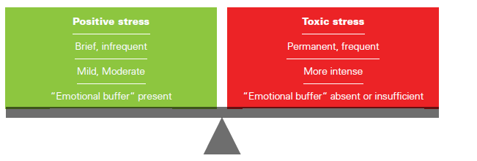
Secure attachment protects a child from toxic stress

Slide 10
What is Resilience?
What is resilience: The product of protective factors or buffers that moderate the negative impact of risk and stress and enable positive adaptation.
Resilient Family = Resilient Child

Slide 11
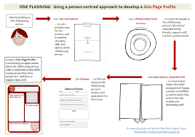
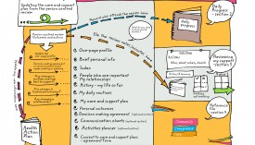

Interview with parents for Child’s Individual Profile based on Person-Centered Planning
Five valued Experiences
Dignity
Relationships
Ordinary Places
Choice
Contribution
Fears
Like/Doesn’t like
Interview with parents
Why is it important to create a child’s individual profile?

Slide 12
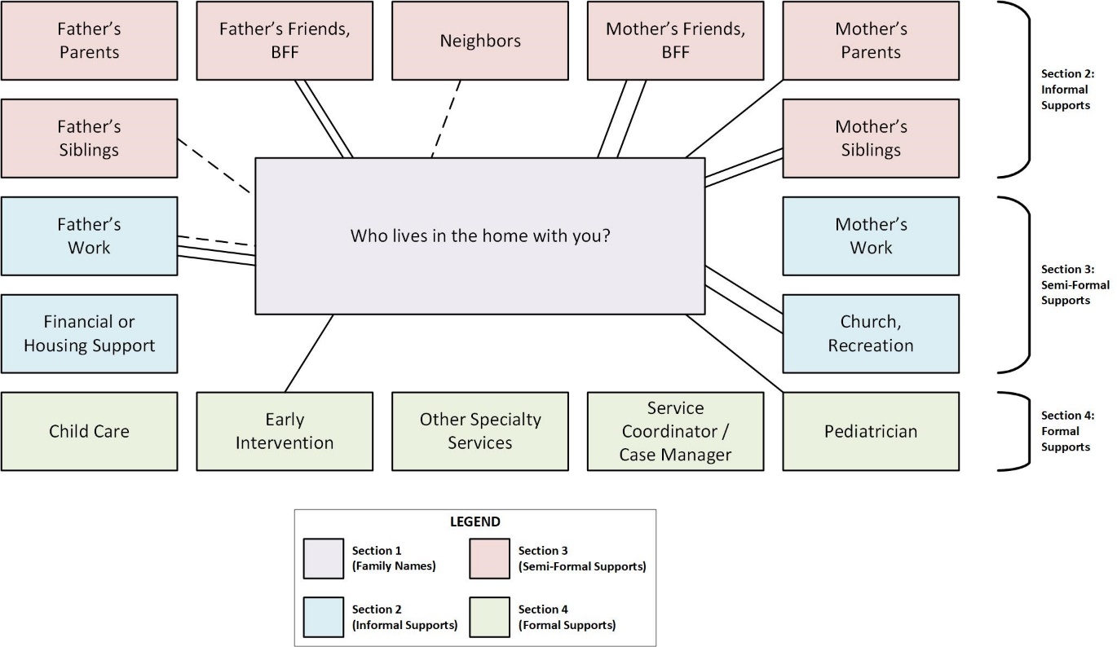
ECOMAP

Slide 13
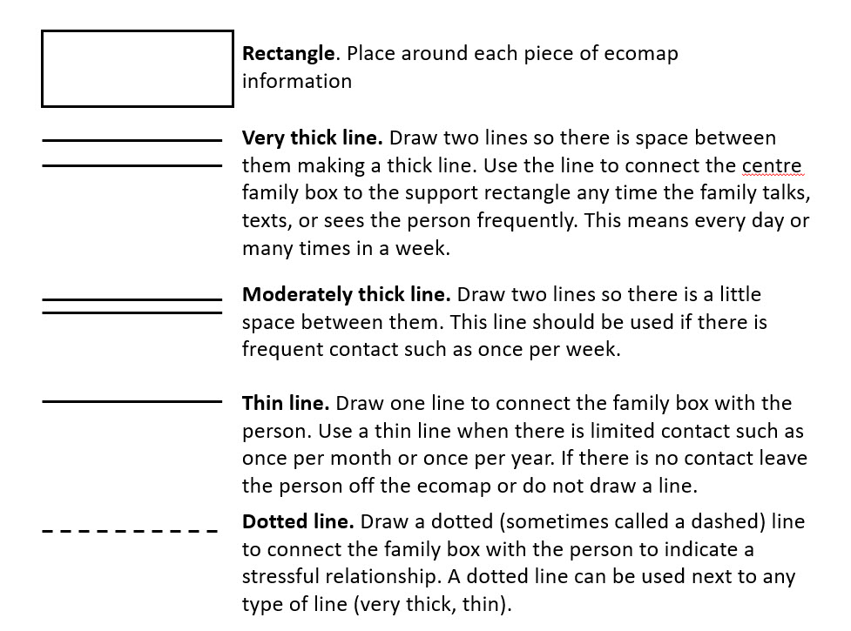
Ecomap lines - meaning

Slide 14
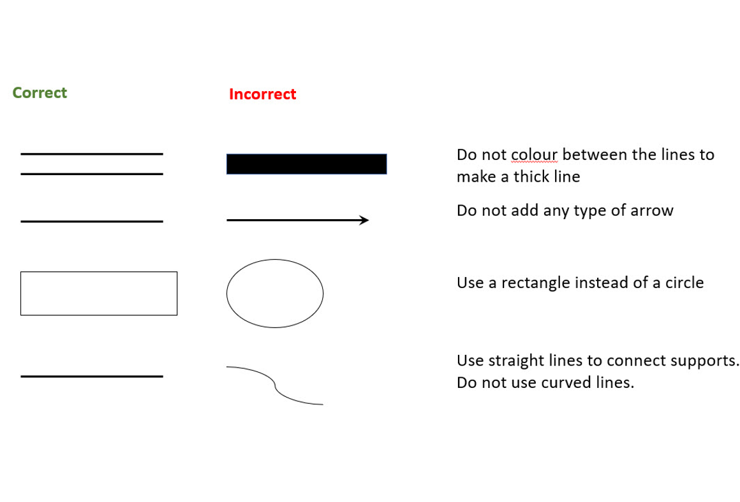
Ecomap lines – correct and incorrect

Slide 15
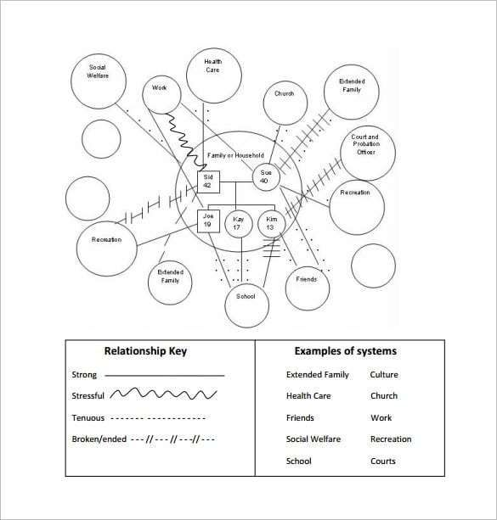
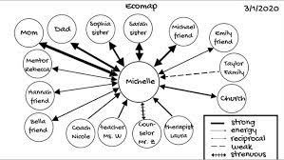
Ecomap examples

Slide 16
Ecomap lines – correct and incorrect

Slide 17
Routine based assessment
What are parents expecting from ECI Specialists?
What do parents actually want from ECI Specialists?
Routine based assessment and intervention
Gathering information from families regarding their interests, priorities, concerns and everyday routines and activities is to develop meaningful child and family outcomes/goals and to design intervention strategies that build on family strengths and capacity
Gathering this information from families is best done through conversations with families rather than through a formal interview or by the family completing the survey form.

Slide 18
Assessment of child and family routines
The following questions can be used to elicit family responses:
Tell me about your day?
What happens most mornings? Afternoons? Nights? Weekends?
Where do you and your child spend time?
What activities do you, your family, and your child like to do (e.g., hiking, going on picnics, playing games at home)?
What activities do you, your family, and your child have to do on a regular basis (e.g., go to the store, give kids a bath, feed the horses, prepare meals, walk the dog)?
What does your child enjoy and what holds your child’s attention? (e.g., people, places, things such as toys, dog, being outside)
What makes your child happy, laugh, and/or smile?
What makes you and your family happy, laugh/smile?
Who are key family members, other caregivers, or important people who spend time with you and your child?
Are there activities that you used to do before your child was born that you would like to do again?
Are there new activities that you and your child would like to try?
Questions were compiled from resource materials by Robin McWilliams, Juliann Woods, Barbara Hanft, M’Lisa Shelden and Dathan Rush by NECTAC, 2005, 2012 / ECTA Center, 2014

Slide 19
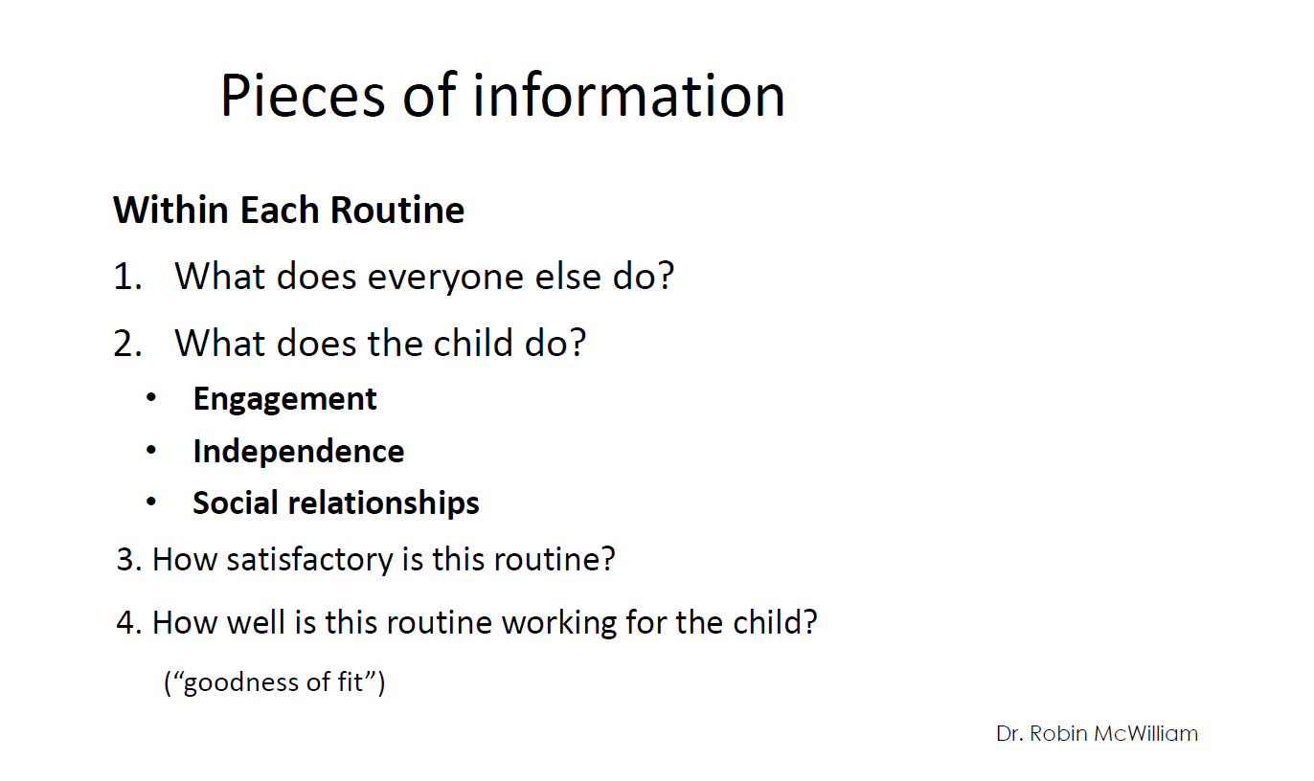

Slide 20
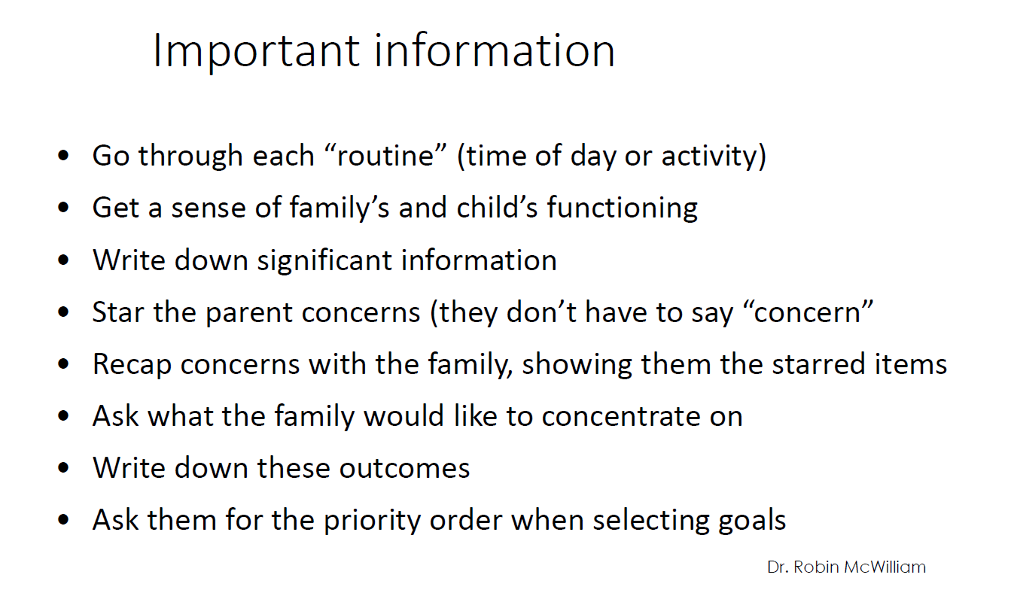

Slide 21
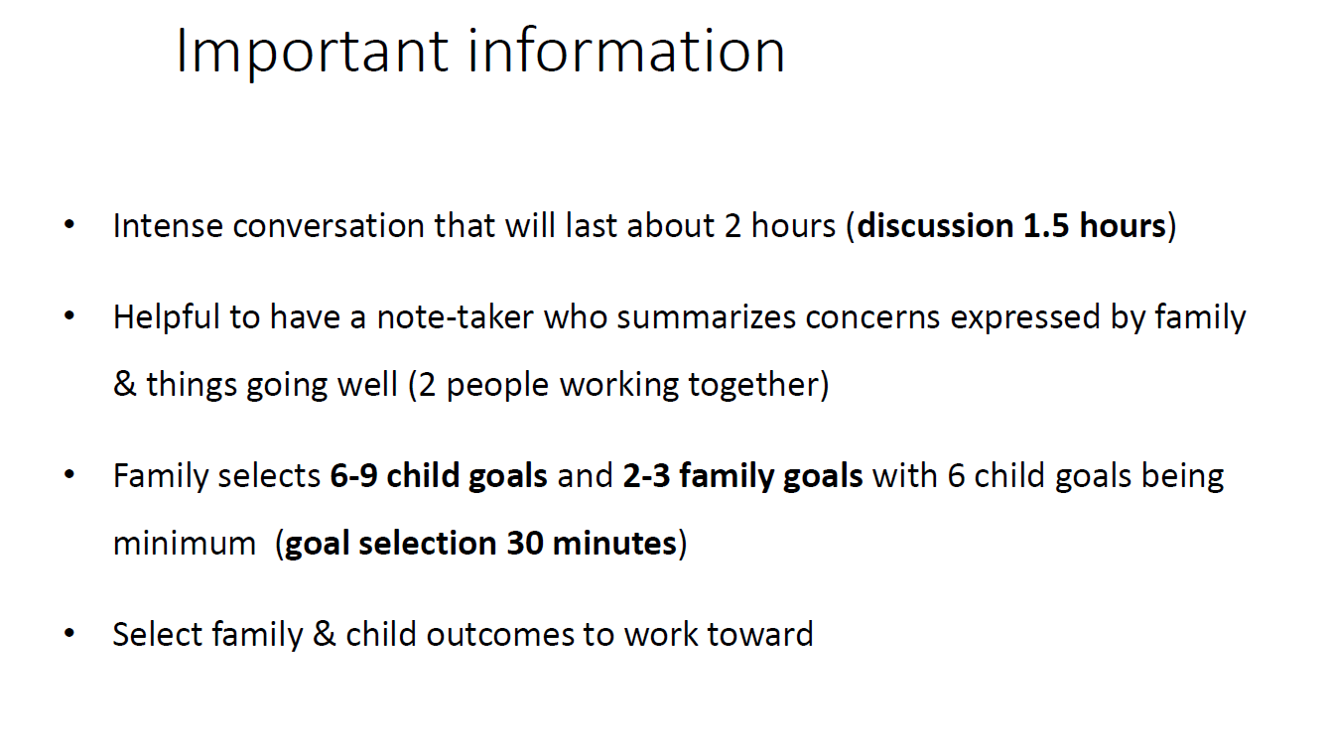

Slide 22
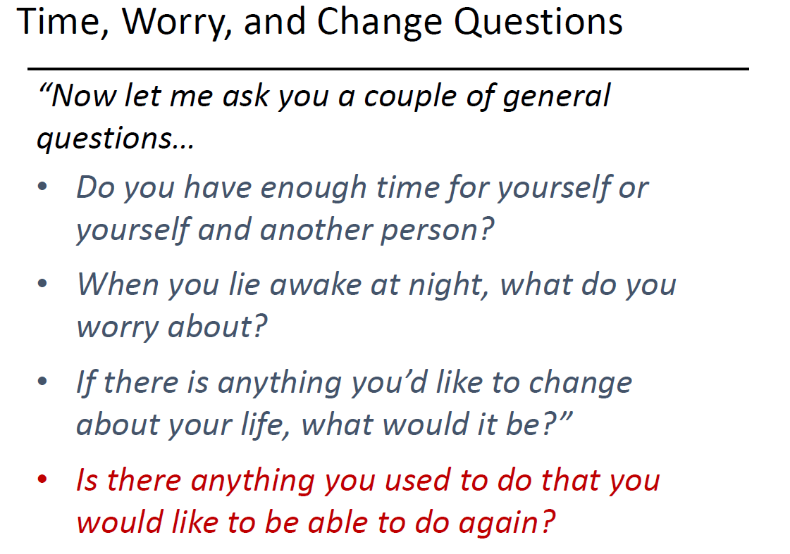

Slide 23
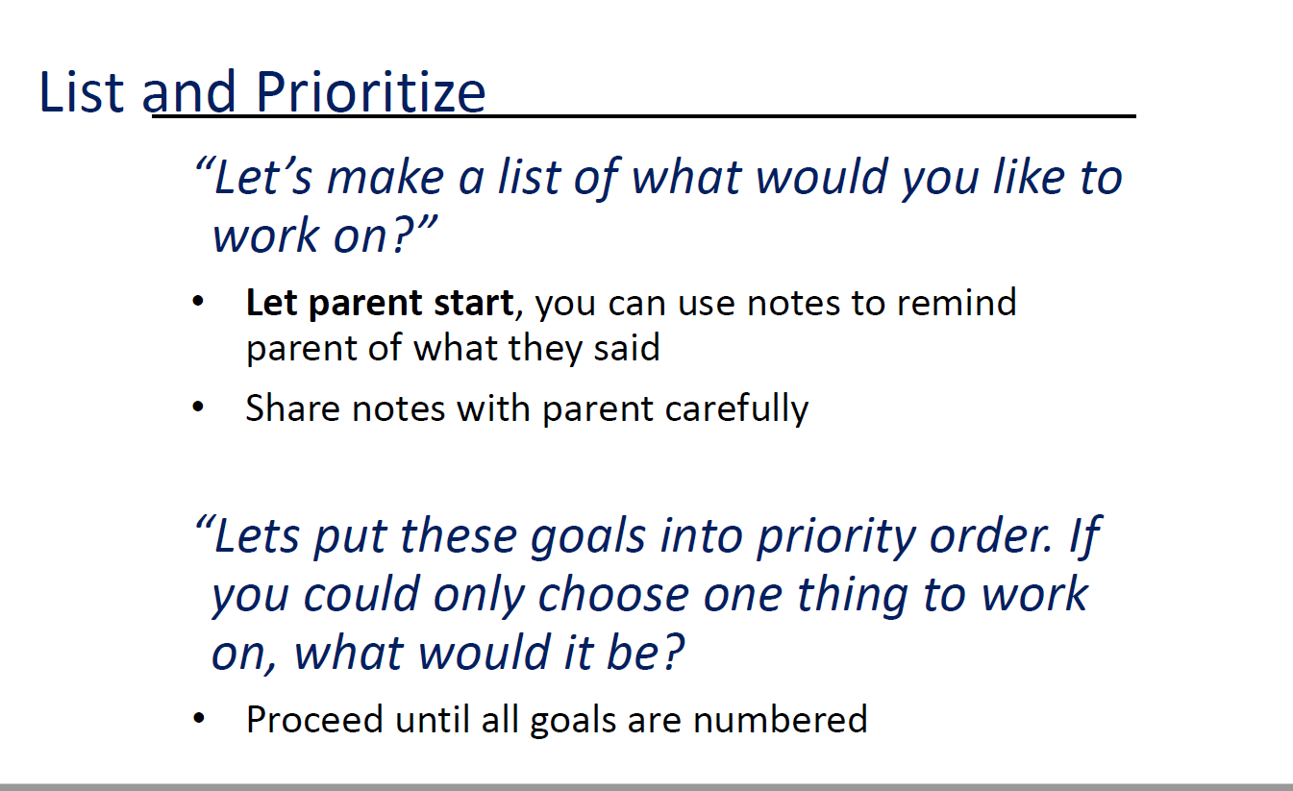

Slide 24
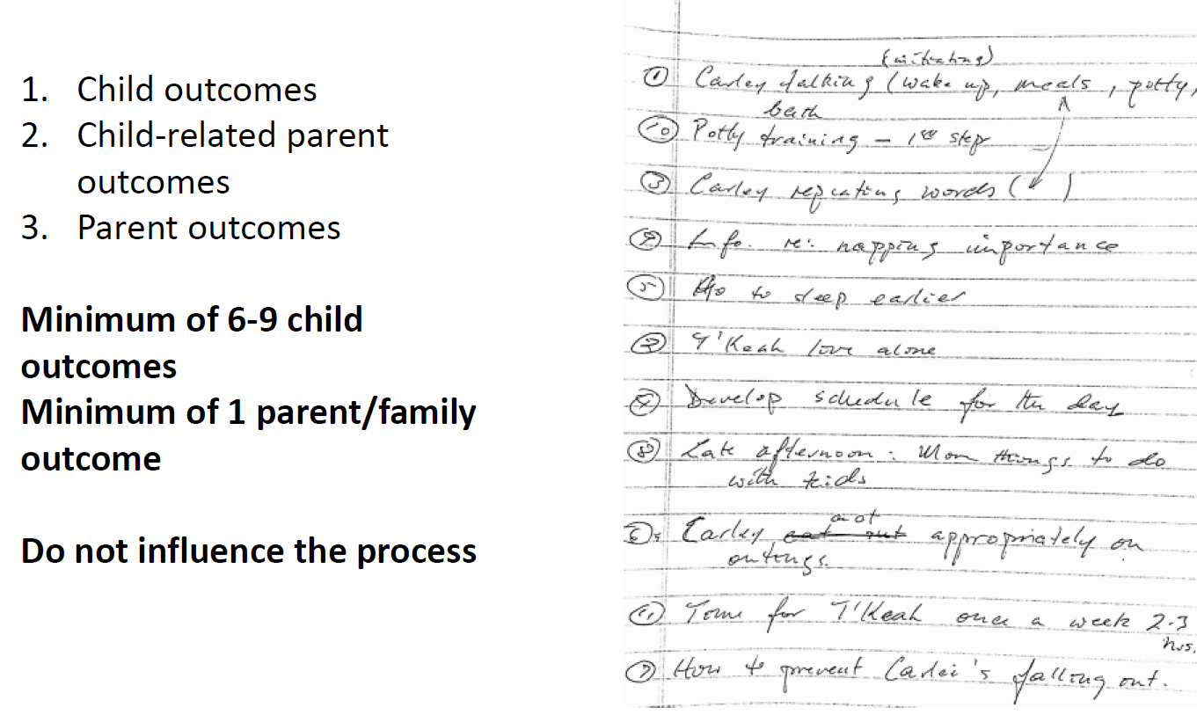

Slide 25
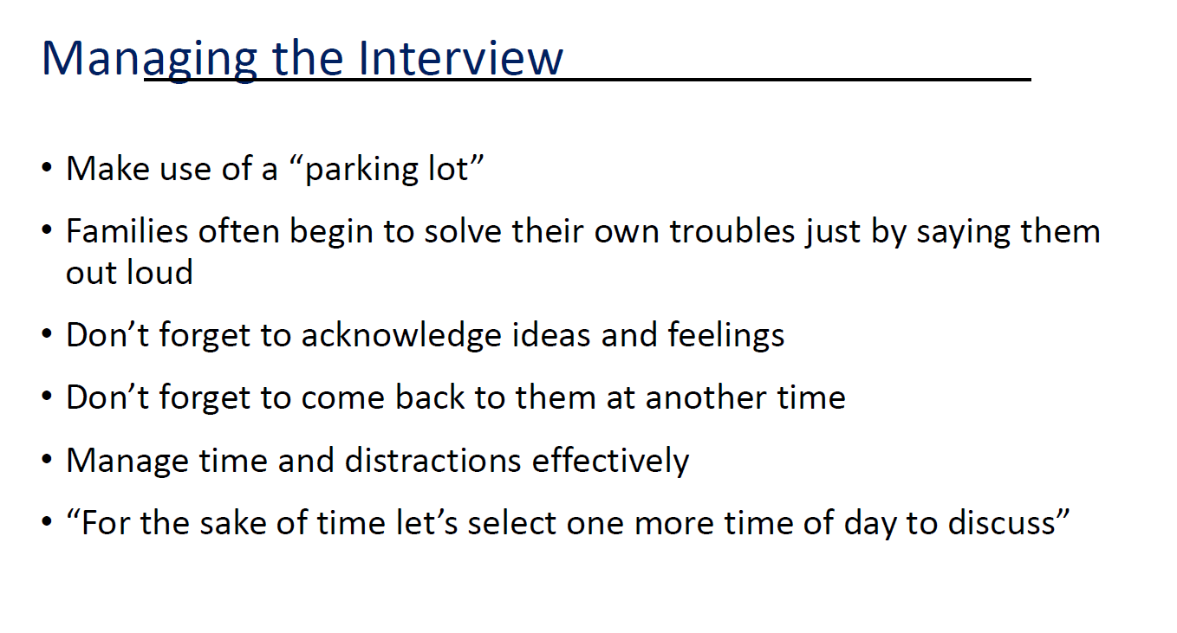

Slide 26
Child and Family Routine Assessment Summary and Analysis
Instruction: The parent completes the family report Routine Questionnaire. At the same time, the specialist in the relevant parts of the form below notes problematic routines, specifically in which part of the routine there are particular difficulties and how the parent would like the child to be involved in the routine activity.
After writing down routines for improvement, the specialist asks the parent to choose the priority routines, for which he wants to develop a work plan for the next 6 months. The highlighted priorities are moved to Child and Family Services Goals and Strategies.
Daytime Segments / Time | Child’s involvement in the daily routines | Priority chose by the parent
Awakening time (morning hygiene): Satisfaction Score: ____ | Child involvement: (How the child is involved / What the child is doing?) Change: | Check if this issue is a priority for you
Dressing / Undressing: Satisfaction Score: ____ | Child involvement: (How the child is involved / What the child is doing?) Change: | Check if this issue is a priority for you

Slide 27
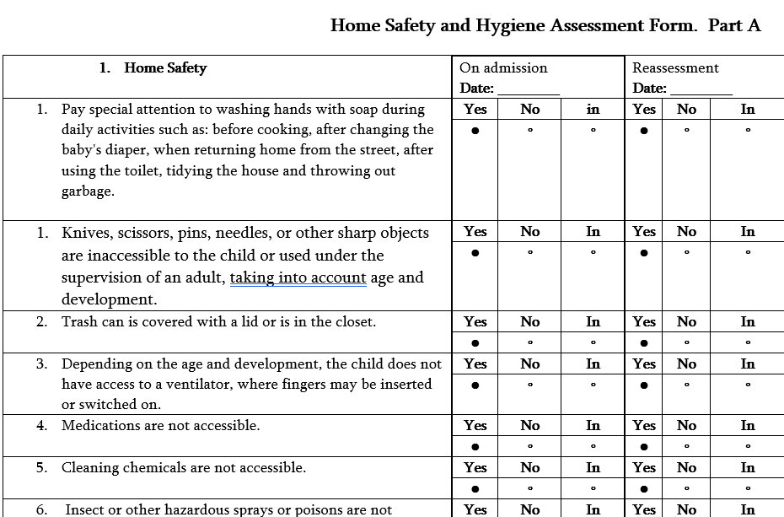
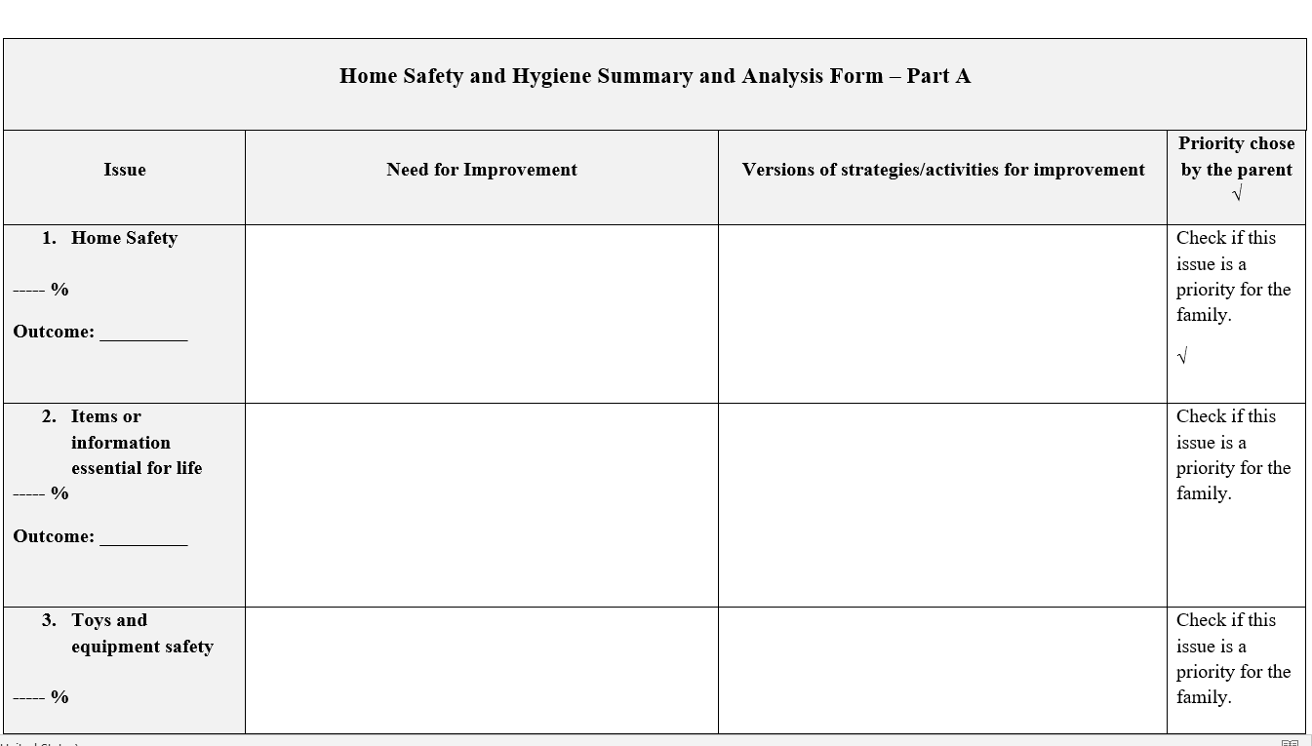
Home Safety and Hygiene Assessment Form Part A

Slide 28
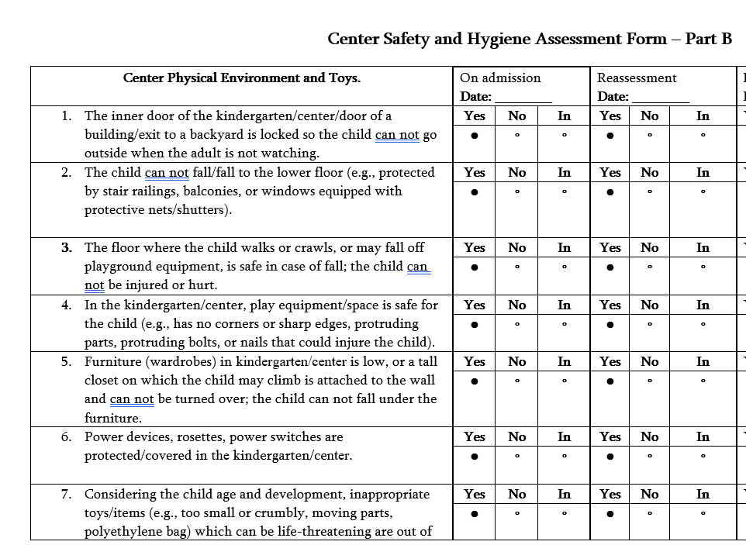
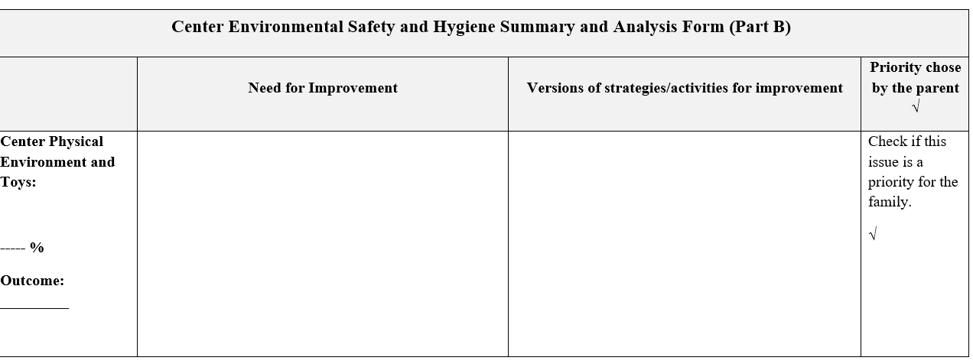
Safety and Hygiene Assessment Form
Part B – ECI Center, Kindergarten

Slide 29
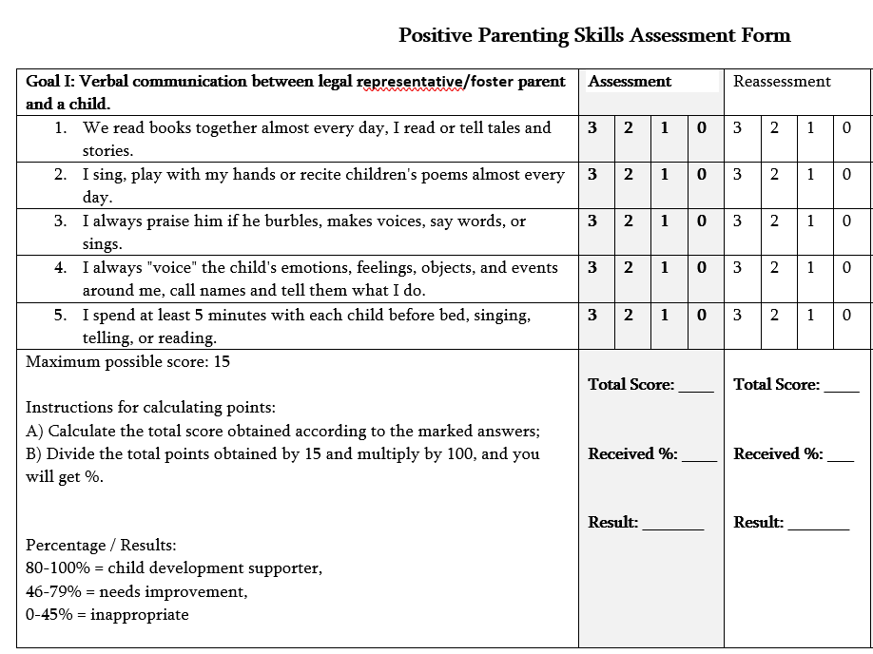
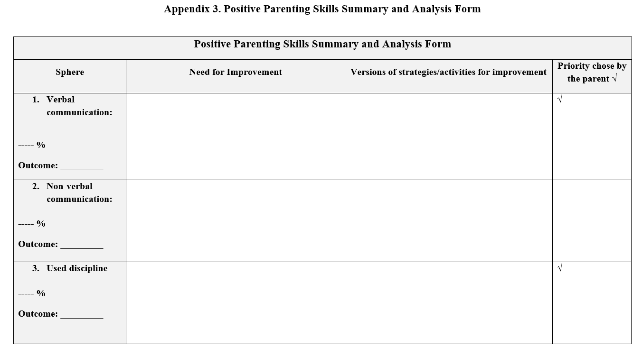
Positive Parenting Skills Assessment

Slide 30



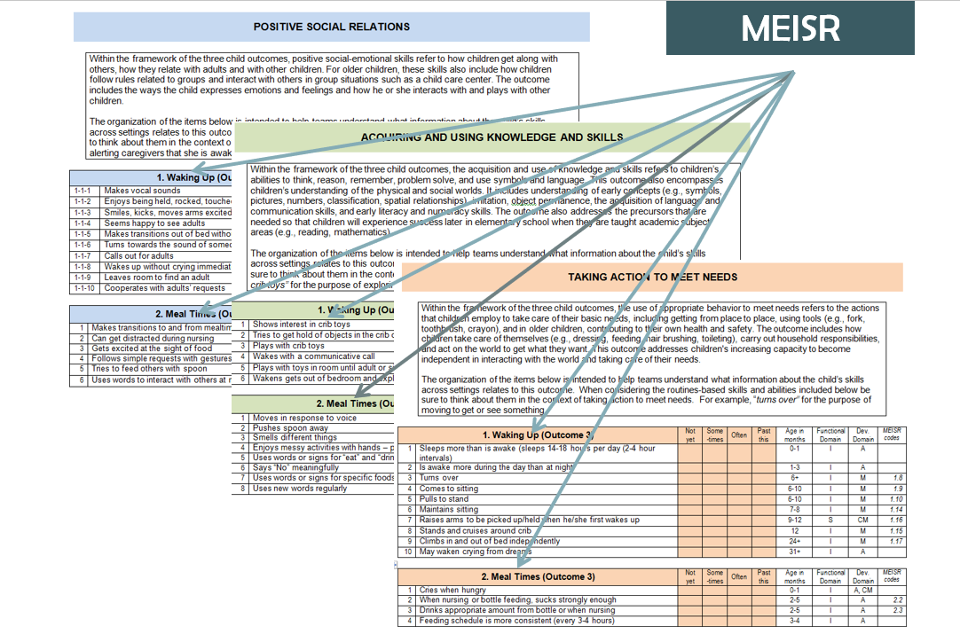
ECI recourses
Parenting Interactions with Children:
Checklist of Observations Linked to Outcomes

Slide 31
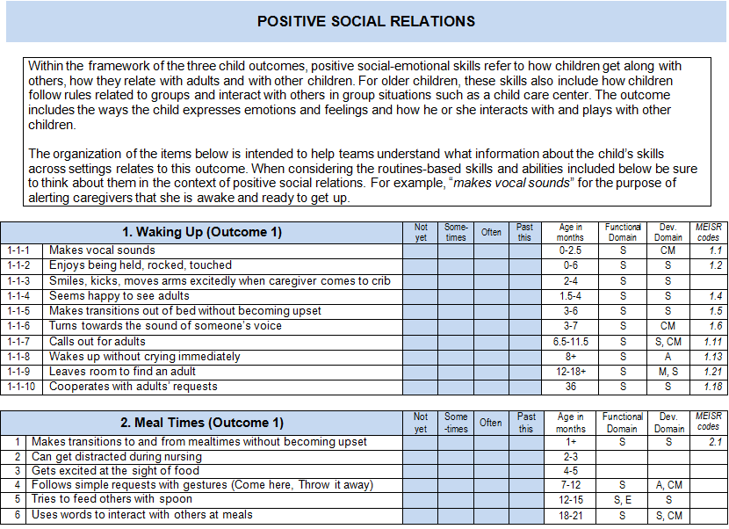
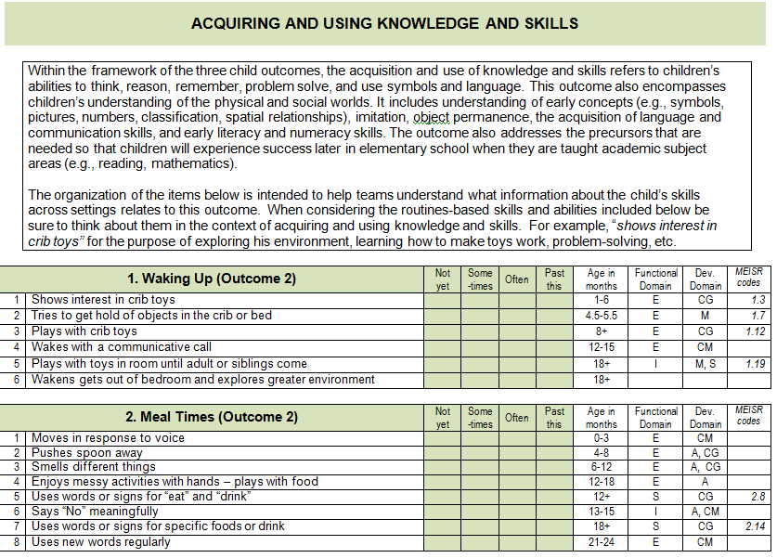
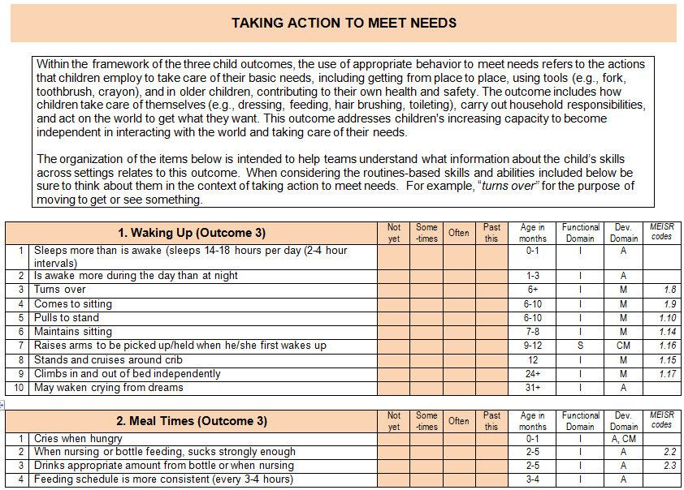
MEISR
31

