Slide 1


Technical Support to implement reforms to support the development of family centred early childhood intervention services in Greece - ECI Greece
Grant Agreement n° 101048313
PPT 6: Early Childhood Intervention Country models

Slide 2



Table of contents
1. Early Childhood Intervention Country models
2. Early Childhood Intervention Program Provision

Slide 3
Chapter 1
Early Childhood Intervention Country models

Slide 4
Questions for reflection
Why does each country need to have an effective ECI system and services?
What kind of ECI services do you need at this stage?
What are the children’s and families' urgent needs?

Slide 5
How long has ECI been implemented | State agencies in charge and funding | Standard policies and practice | Theoretical and conceptual framework | ECI Professionals and training requirements
US, Oregon The late 1960s, early 1970s | Service delivery: Children 0 – 3 served by the Department of Education or The Department of Health or the Department of Human Services depending on State decision 3 to 5 years of age are served through the Department of Education in all states. Funding: Federal funds are provided for all states (20-25% of the total costs). The rest is funded by state public funds and public and private insurance reimbursements. | The federal law called the IDEA (The Individuals with Disabilities Education ACT) which made special education Federal laws and regulations and state laws and rules establish general standards that are consistent across all states. In addition, national professional organizations set more detailed quality standards | Research evidence from many different disciplines supports early intervention and various methodologies. | Early interventionists Early Childhood Special Educators Speech and language pathologists Occupational therapist Physical therapists Autism specialists ECI and Early Childhood Special Educators typically have one license, educator preparation. Each of the other professions has national and state licensing requirements for their profession.
Portugal Initially 1980-90 2008 Special Needs Education Act created a National System for ECI | Service delivery: ECI professionals belong to Health, Social Security, and Education sectors. Funding: by Structural Funds in accordance with national and Community legislation applicable, in particular, the European Social Fund Free of charge | Guidelines for ECI have a national range. ECI is based on an inter-sector relationship. Each sector has its own competencies (health, social, education) and is defined in ECI law. | Individualized, comprehensive, family-centered services. Parental involvement in the intervention process is an essential feature for the success of ECI service in Portugal | Early Childhood Intervention involves professionals such as Medical doctors; Nurses; Therapists; Social workers; Psychologists; Child carers, preschool teachers, specialized ECI Teachers. In-service training is required for ECI specialists, provided by recognized professional organizations
Notes:
Bronfenbrenner ecologic theory, the German model (that family is the primary place of socialization of the child and the ECI should be delivered where the child is living (it means home-based

Slide 6
How long has ECI been implemented | State agencies in charge and funding | Standard policies and practice | Theoretical and conceptual framework | ECI Professionals and training requirements
Spain, Catalonia: Since 1970s child-focused, clinical model 2000- family-focused, the transformation process has been started | Service delivery: by different government departments and different levels of government whose coordination is essential. Funding: The government of each Autonomous Community - Social Welfare | The Department of Social Welfare is responsible for planning, although there are a few differences across autonomous communities exist | Adopting the social and ecological perspectives of human development and systems theory recognizes the central role of families. Community-based interventions - families are typically treated in the ECI service facilities and only rarely will the professional visit the patient home. Interdisciplinary approach | Provided mostly by psychologists but may also include speech therapists, physical therapists, neurologists, social workers, and teachers. Training requirements: major in psychology, speech therapy, etc., and on-job training. Several universities in Spain offer a master’s in ECI but it is not a requirement although it is considered a plus when applying for a job
Austria Since 1980, Federal government, 9 autonomous provinces | Service delivery: The ECI public service is made available by the National System and is free of charge for families. ECI services are decentralized Funding: education services are supported by local social authorities Clinical services (speech; physio) are private or hospital-based, financed by health insurance | Partly - due to the federal status | Influenced by Bronfenbrenner ecologic theory & psychoanalytic theory Communications model - The communicational model is based on a partnership model of early intervention that emphasizes the importance of shared and defined responsibility between parents and professionals Interdisciplinary approach | Requires basic professional training (e.g. psychologist, special educator, nurse...) ECI Specialists have special training provided by local organizations. (special pedagogical services)
Source: Guralnick, M.J. (2005); The Developmental Systems Approach to Early Intervention; 16, 425 - 439 ; 22, 543-571

Slide 7
How long has ECI been implemented | State agencies in charge and funding | Standard policies and practice | Theoretical and conceptual framework | ECI Professionals and training requirements
Georgia Initially 2009 – only one organization Nationwide since 2012 | Service delivery: NGO’s registered at State Social Agency Funding: Ministry of Labor, health, and Social Welfare through State Social Agency Service is free of charge for families. The annual budget is adjusted to the demand (number of eligible children, service providers' caseload capacity) Way of Funding – the family gets a voucher for the service and get 8 visits per month in the natural environment Child and family choose the ECI service provider organization and is able to change the service provider in case of need | ECI state subprogram is part of the state “Social Rehabilitation and Child Care” program, developed by MoLHSA and approved by the Parliament State service standards developed by MoLHSA with the collaboration of the ECI coalition (NGO) | Bronfenbrenner ecologic theory, Biopsychosocial approach Child oriented and Family Focused Implemented in Natural environment – Birth to 30 months, child – parents group sessions at ECI centers from 30 months – 7 years home/kindergarten/school. group sessions with children at ECI centers Transdisciplinary approach | ECI specialist – professionals (Psychologists, OTs, physical therapists, speech and language specialists, pediatricians, Social workers) and Paraprofessionals (at least Bachelor’s diploma in any discipline) Diploma + ECI pre-service training certificate + on the job training ECI professionals could become supervisors and provide professional supervision to other ECI professionals and paraprofessionals ECI supervisors have to get special certification

Slide 8
ECI in services at the system level – country examples
Summary:
Initial implementation of ECI services started between 1960 – 1990, medical model;
The shift of ECI service paradigm - from the 2000s, was preceded by changes in legislation related to the protection of human, children’s right
Theoretical framework: Ecological and Systems theory*
Aim of ECI services: Improve the development of all children with special needs (biological, social, psychological) at an early stage (before 3 years) and their environment (family, educational, social)
The role of Government and State agencies: policy development at the federal and state/municipal level, service coordination
Funding: ECI is free of charge for families is funded by the government sector or insurance
Professionals and training Requirements: representatives of different disciplines from education, special education, social sciences, medicine; Training requirements: Bachelor degree, ECI certification
Notes:
*Bronfenbrenner's ecological systems theory focuses on the quality and context of the child's environment. He states that as a child develops, the interaction within these environments becomes more complex. This complexity can arise as the child's physical and cognitive structures grow and mature.The ecological systems theory holds that we encounter different environments throughout our lifespan that may influence our behavior in varying degrees. These systems include the micro system, the mesosystem, the exosystem, the macrosystem, and the chronosystem.

Slide 9
Service Delivery Models
Capacity Building Paradigm | Traditional Paradigm
Promotion Models Focus on enhancement and optimization of competence and positive functioning | Treatment Models Focus on remediation of a disorder, problem, or disease, or its consequences
Empowerment Models Create opportunities for people to exercise existing capabilities as well as develop new competencies | Expertise Models Depend on professional expertise to solve problems for people
Strengths-Based Models Recognize the assets and talents of people, and help people use these competencies to strengthen functioning | Deficit-Based Models Focus on correcting peoples’ weaknesses or problems
Resource-Based Models Define practices in terms of a broad range of community opportunities and experiences | Service-Based Models Define practices primarily in terms of professional services
Family-Centered Models View professionals as agents of families and responsive to family desires and concerns | Professionally-Centered Models View professionals as experts who determine the needs of people from their own as opposed to other people’s
Chart From: Dunst, C. (2005). Framework for Practicing Evidence-Based Early Childhood Intervention and Family Support. CASEinPoint, Vol. 1, no.1.

Slide 10
Recommended Practices in Early Childhood intervention
Routine-Based family-centered intervention
Establish a relationship of affection and attachment with the child that can’t be replaced by anyone else. Elimination of risk factors due to poor parenting skills or other family risk factors
Child learning and development is an ongoing process that can take place in any daily situation in which the child is actively involved
Even having limited time to be with the child, parents have much more opportunities to interact and promote the development of children than any other adult or professional will ever have
Intervention in a natural learning context
support children’s development through everyday routine, at home, kindergarten, school or anywhere child spends his/her time
Support people around the child to support a child’s development through everyday activities and use naturally emerged situations as learning opportunities
Teamwork preferably transdisciplinary, See below
Coordination and integration of services and resources at state and service level

Slide 11
Models of Team Interaction
 | Multidisciplinary | Interdisciplinary | Transdisciplinary
Assessment | Team members conduct separate assessments. | Team members conduct separate assessments. | Team members and family conduct the joint assessment.
Parent Participation | Parents meet with team members individually. | Parents meet with the entire team or a representative of the team. | Parents are full, active members of the team.
Service Plan Development | Team members develop separate, discipline-specific plans. | Team members develop separate, discipline-specific plans but share them with each other. | Team members and families develop joint plans based on family concerns, priorities, and resources.
Service Plan Responsibility | Team members are responsible for their discipline-specific plan. | Team members share information with each other about their part of the plan. | Team members are jointly responsible and accountable for how the primary service provider implements the plan.
Service Plan Implementation | Team members implement their discipline-specific plans. | Team members implement their portion of the plan and incorporate other sections where possible. | A primary service provider implements the plan with the family.
Lines of Communication | Informal | Occasional case-specific staffing. | Regular team meetings to exchange information, knowledge, and skills among team members.
Guiding Philosophy | Team members recognize importance of information from other disciplines. | Team members are willing to share and be responsible for providing services as part of the comprehensive service plan. | Team members commit to teach, learn, and work across traditional discipline lines to implement a joint service plan.
Staff Development | Independent and discipline-specific. | Independent within and outside of own discipline. | A critical component of team meetings for learning across discipline boundaries and for team building.

Slide 12
Early Intervention team – service provision
Transdisciplinary Approach – cost effective | Interdisciplinary Approach
An early Interventionist is the primary service provider and case manager Team of specialists is supporting the ECI specialists with specific knowledge and experience Transdisciplinary Team is meeting on Example: 3-year-old boy with developmental delay in cognitive, motor, communication spheres. ECI service composition: Key service provider is ECI Specialist who visits the child in the natural environment (home, kindergarten) twice a week. The home visits: ECIS supports the family to learn and practice new parenting and child development skills in the home setting to stimulate the holistic development of a child. Works together with family to identify daily routines when child development activities could be performed. Goals and activities identified by the family are based on a comprehensive evaluation of family and child resources and needs, daily routine, and activities. Visits in kindergarten EI interventionists share assessment results and family goals with a teacher, they plan together how the same goals could be integrated into group activities. The role of the T Team: occupational therapists and speech and language therapists are enriching the knowledge and skills of ECI specialists in gross motor and language development. Support to make adaptations in kindergarten environment and activities. Other discipline representatives (psychologists) could be invited if needed. | Different specialists are providing services Team members develop separate, discipline-specific plans but share them with each other Team is meeting on regular bases One of the team members is Case Manager Example: 3-year-old boy with developmental delay in cognitive, motor, communication spheres. Service is delivered by a psychologist – who works on cognitive development ECI specialist/occupational therapist- adaptations and adaptive skills at home or/and kindergarten Speech and Language therapist - alternative communication and/or speech development

Slide 13
Benefits of Transdisciplinary Team:
Collaborative Approach
Transdisciplinary team members, including parents:
work together to develop an intervention plan
work on common goals
team members meet systematically and professionals share expertise with each other
team members support Primary Service Provider
professionals are available to the family as needed
Reinforces natural way of learning
Interventions fit the way a child learns
Duplication of services/supports is decreased
Primary Service Provider (PSP) is the person who communicates with a family in a systematic way
The way of communication with family is consistent, communication style is familiar for both sides
Requires time to collaborate

Slide 14
Transdisciplinary Team:
Parents and other care providers are equal team members
Outcomes/goals are developed based upon improving the child’s participation across activity settings and learning opportunities
Team members are jointly responsible and accountable for how the primary service provider implements the plan
Team members provide coaching to the PSP to effectively implement the plan across activity settings and care providers
Ongoing interaction among team members for reflection and sharing information occurs beyond scheduled meetings
Service and care providers engage in learning and coaching to develop the necessary expertise to improve the child’s participation across activity settings and learning opportunities
Team members implement an annual team/professional development plan to identify any gaps in skills and knowledge and improve expertise across disciplines

Slide 15
ECI Service provision Country models
Summary
The ECI service paradigm shift: from the traditional, medical, child-focused model to cost-effective, capacity building, family-focused model
Team: Interdisciplinary/transdisciplinary
Eligible Children: with a disability, developmental delay, or at risk of developmental delay in one or more areas
Age range and place of service provision: birth to 3 and 3 – 6. With children from birth to 3 mostly home visiting, from 3 to 6 at educational settings

Slide 16
Group Activity – divide into 3 groups
Exercise: create an optimal National ECI model for Greece with consideration of the main philosophy and principles of ECI and country resources – economic, social, human, professional:
ECI philosophy and principles | ECI country need and resources
ECI service is available for each child with special needs or at risk; Service is free of charge for families Promotes child development and family strengthening Promotes child and family social inclusion Prevents severity of disability of children with established diagnoses (ASD, CP, Genetical); Developmental delay due to biological (low birth weight) or psychological or social (family violence) | - Children’s and their family needs Economical Cultural Experience Human and professional resources
What is the contexts of ECI national system development What is the unique what you already owned What will be unique

Slide 17
The context of ECI system development in Georgia
Urgent need - 2008 - 2012
Support the Deinstitutionalisation of Thousands of Young Children in Orphanages
Prevention of child abandonment and gatekeeping
Close down big institutions
Development of services for children at risk or with disabilities and their families
Strengthening of social welfare

Slide 18
CHILD CARE - Programs organized by the Ministry of Labor, Health and Social Protection
CHILD ADOPTION | ALTERNATIVE FORMS of CHILD CARE
Adoption; International Adoption; Guardianship | Reintegration; Foster Care; Small Group Homes;
CHILD DEFENCE FROM ABUSE AND NEGLECT | FAMILY ASSISTANCE – PREVENTIVE ACTIVITIES
Assessment, Consultation, Placement to appropriate services if necessary, Guardianship | Day Care Centers (6 – 18); Mother – Child Shelter
HABILITATION - REHABILITATION | EARLY CHILDHOOD INTERVENTION/DEVELOPMENT
Center based rehabilitation for children with physical disabilities (0 - 18) | Home based intervention for children (0 – 7) with developmental delays and at risk and their families
SHELTERS FOR HOMELESS CHILDREN 24 hour care, schooling for children up to 18 | ASSISTANCE TO CHILD AND FAMILY IN CRISIS Food and household appliances for families in poverty

Slide 19
Inclusive Preschool and school education Ministry of Education and Science
EPE Law
Every child has the right to education and should be involved in mainstream preschools/schools
Early Childhood Care and Education State Standards
Formal procedures of transition from preschool to school Guidelines and Multidisciplinary teams in every region
Projects enhancing early inclusive education supported by local and international donor organizations
No formal procedures of transition from ECI to preschool only agreement between Ministries and ECI providers

Slide 20

Questions we had before starting TO build THE ECI system
How to change approaches in society:
Disability as a defect
The best solution is institutional care
Treatment with medications
Rehabilitation is the only possible service
How to change established attitudes?
Shame and Stigma for Families
How to change the medical approach into social/biopsychosocial? How can Early Childhood Intervention Values be adopted in society?
Are our professionals (psychologists, OTs, SP&L therapists) ready to provide evidence-based ECI?

Slide 21
Starting point - Changing approach of families and society through medical doctors
Having realized that the healthcare system and primary healthcare settings are the only institutions that can reach all children and families, we started working with them
  Implemented activities:
  Workshops, trainings aimed at rising awareness of medical doctors and other professionals by getting evidence-based information regarding best practices from reliable local and international organizations (professional societies, unions)
  Involving MDs in the process of identification of children at risk and equip them with appropriate screening tools (scientifically reliable and valid, adapted to culture, brief, user-friendly, easy to learn and administer)
  Creating ECI services and referral system in capital and in the regions
  Introducing successful cases of early identification and ECI outcomes

Slide 22
How to use our professionals expertise for THE Creation and provision of evidence-based ECI service
  Implemented activities:
  Training of trainers of professionals
  Creation of pre-service training module for ECI specialists
  Creation of in-service training modules for ECI specialists and professional supervision
  Train new specialists
  Use experienced professionals’ expertise: to conduct training professional supervision, mostly are engaged in a transdisciplinary team and support primary providers (ECI specialists,) and at the same time are working in clinical settings (habilitation – rehabilitation, autism program, etc.)

Slide 23
ECI Service in Georgia
ECI services in Georgia are organized and funded by the Ministry of Labour, Health and Social Affairs (MoLHSA)
The special program for “Social Rehabilitation and Child Care” is being developed by MoLHSA and is approved by the Government of Georgia on the annual basis
The Social Protection Department of MoLHSA is responsible for the policy design
State Social Agency is the executive agency
About 40 NGOs or private organizations are registered in Social State Agency as ECI service providers and serves 2500 children in 8 regions out of 10

Slide 24
Aim of the State ECI program
Prevention of institutionalization of infants and children with special needs and provision of high-quality services based on individual needs and strengths of children and families, promote social inclusion of children with special needs, empowering of families.

Slide 25
State ECI Program
Program objectives:
Holistic development of children with special needs
Prevention of severe disability and children’s abandonment
Promotion of social integration of a child and Strengthening capacity of families
Target group: children from birth to 7 having a developmental delay in one or more developmental spheres (motor, cognitive, social, emotional, communicative, and adaptive); or established disability; or being at risk of developmental delay
Registered ECI Provider organizations: should own an office, curriculum-based assessment tools, Inter/transdisciplinary team composed of at least one certified ECI specialist and representatives of different disciplines such as; a psychologist and an occupational therapist, a speech and language therapist. Every specialist should have at least a BA diploma and certificate in ECI

Slide 26
Funding and terms of ECI state program
Enrollment limit – every eligible child throughout Georgia
Annual budget is adjusted to the demand (number of eligible children, service providers' caseload capacity)
the government funds 100% of service
Way of Funding – a child gets a voucher for ECI service and gets service in the natural environment. ECI specialist (primary service provider) conducts visits in the natural environment (mainly at home from 0 to 3, or kindergarten 3 - 6) twice a week, 8 times per month. The ECI voucher covers one hour of professional supervision. In case of need, group sessions could be conducted in the ECI center for children under 3 years and their parents 2 times out of 8 visits, and for children, 3+ group sessions could be 4 times out of 8 visits.
Child and family choose the ECI service provider organization and can change the service provider in case of need

Slide 27
The Early Childhood Intervention State Model in Georgia is based on the following philosophy and principles:
Based on Developmental and Biopsychosocial Approaches
Family is the Main Focus of the Service
Service is Implemented in Natural Environment, Where Child Spends Most of His / Her Time
Service is provided according to Child’s and family Needs, Twice a Week
With Involvement of Major Caregivers
Assessment, Planning, Implementation, reassessment
Transdisciplinary Team - Case Manager/Primary Service Provider (Professionals and Paraprofessionals), Parents, professionals of different disciplines according to child and family needs.

Slide 28
Specification of different services for children with special needs - Rehabilitation, Habilitation and Early Intervention
Rehabilitation - Special healthcare services that help a person regain physical, mental, and/or cognitive abilities lost or impaired due to disease, injury, or treatment.
Rehabilitation – regaining lost skills or functioning
Habilitation - refers to services for those who may not have developed the skill or function yet, as it is expected for the particular biological age. Such as a child who is not talking as expected at his or her age.
Habilitation – acquisition of not existed skills or functions
Early Intervention - Designed to eliminate the identified risk factors of child development. Promotes a child's holistic and functional development.
Early Intervention – holistic development of a child through family strengthening

Slide 29
Outcomes of Early Childhood Intervention in Georgia
Is Based on Developmental and Ecological Approaches, Consequently, it Leads to Complex Results:
Adaptation of Parents to Child’s Diagnoses
Parent-Child Secure Attachment
Development of Child’s Full Potential
Intellectual and Academic Achievements
Behavioral Adaptation
Better Quality of Life of Entire Family
Early Intervention Prevents:
Child’s Separation
Couple's Separation
Family Dysfunction
Disability Status
Health Problems
Social and Criminal Issues
Family Economical Issues
Parental Incompetence

Slide 30
Results of Advocacy and awareness building
Enrollment of Children with Special Needs in Preschool Education System
One of the aims of ECI organizations in Georgia is strengthening the capacity of preschool teachers in supporting children with special needs:
Training and Individual Counseling of Teachers
Working with children together with the teachers to assess the needs of children and set Individual Goals.
Teachers underlined that ECI specialists equipped them with practical knowledge, decreased their concerns about how to address the needs of children with disabilities and behavioral problems
ECI plays a unique role in the transition of children into mainstream education.

Slide 31
Preschool Teachers opinion regarding children with special needs and their parents who have been involved in ECI services
Parents are familiar with their children’s abilities: strengths and difficulties
Parents are informed about their children’s rights, inclusive education and individual approaches
They have appropriate expectations...
Children are more independent, are functionally and socially in a higher level. Their academic skills are more developed

Slide 32
Empowering of Parents
Families having children with disabilities face higher risks for divorce, unemployment, and poverty. In many cases, parents avoid having a second child.
Early Childhood Intervention helps families to:
See strengths and a future for their children
Deal with obstacles and concerns together
Remain or Become employed
Keep their social lives
Have more children
Empower other parents

Slide 33
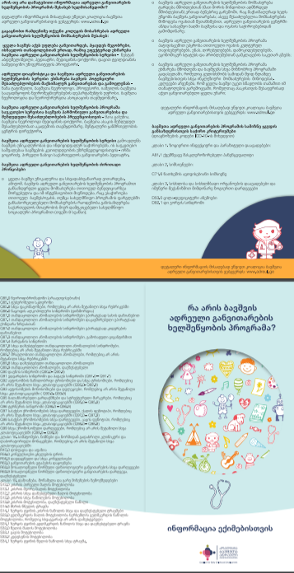
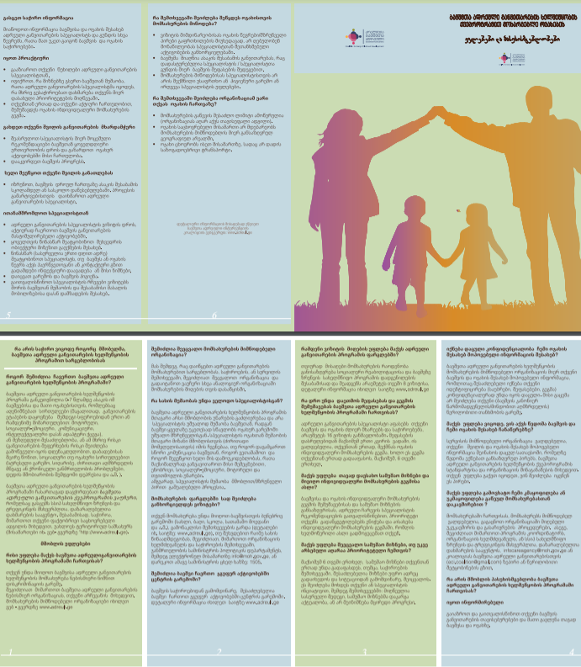

Awareness raising and Outreach Activities
Community Mobilization Activities:
Free developmental screening in regions
Workshops with parents, state social workers, medical and kindergarten personal
Media programs/videos/clips
Parents’ Box
www.adreuli.ge
Georgian application for child development screening

Slide 34
Factors that influenced ECI system development in Georgia
The National Child Care Reform (2006 – 2014):
- From Medical to Social Model
- From Institutional Care to Family Type Care and Parent’s Strengthening
Low Budget Early Intervention Service Model has been proposed to the government (2012)
ECI State Concept Approved by Parliament with Obligation of Strategic Planning:
- Three Years National Action Plan (2018 – 2021) of ECI System Development has been developed and started implementation
Strong Nongovernmental Sector and Support of International Organizations

Slide 35
What the nongovernmental sector has done to create a national ECI system
Establishment of a coalition of ECI organizations
ECI National Strategy and Action Plan
ECI National Policy & Procedure Document
ECI service standards which were later adopted by the government
Developed Child Development Screening and Surveillance Protocol
Advocacy work of NGOs, parents organizations, and Individuals to adopt ECI concept note based on ECI national strategy by parliament
Development of ECI model for mountainous and remote regions
Development of methodologies and tools to support inclusive preschool education
Certified courses for ECI Specialists

Slide 36
Frequent Challenges in ECI system
Better to be considered ahead
Flexible, diverse, and coordinated funding scheme for ECI state program
Intergraded system and coordination between primary healthcare, social services, educational programs - lack of continuous and effective communication with primary care providers and preschool facilities
Early Identification and timely referral by Primer Health Care system
Engagement of Children with complex special needs in mainstream education
The limited availability and supply of human resources for ECI system at the national level (in every region)
ECI specialist profession’s formal establishment
High-quality University level education programs, pre and in-service training

Slide 37
General Recommendations for High Quality ECI System Development
Ensure the highest level of Government commitment for the development and full implementation of ECI services
Ensure support at the municipal/community level for ECI services
Develop appropriate costing and budgeting system for ECI services - diversification of funds
Maintain and strengthen collaboration with international partners to ensure technical and financial support for ECI program development
Develop an appropriate regulatory framework for ECI national services
Develop National ECI strategy and the Operational Plan
Develop nationwide surveillance and screening preferably at the Primary Health Care level,
Develop a strong system of referral and transition
Working team on ECI national strategy development 2015, Georgia; lead by Emily Vargas-Baron

Slide 38
General Recommendations for High Quality ECI System Development
Create Policies and Procedures for ECI services as the guiding document of ECI service provision (Service provision standards, Professional standards, etc.)
Develop eligibility criteria according to biological, psychological, and social risks to developmental delay. Create relevant evaluation tools for identification and measurement of social or psychological risks
Ensure the existence of services for early age children requiring intensive and individualized interventions for malnutrition, chronic illnesses, disabilities, atypical behaviors, rehabilitation, or any other intensive interventions.
Develop short-term and long-term educational programs to prepare and supply professionals for the ECI system.
Develop Early Intervention as a specialization requiring BA and/or MA level education
Develop national M&E system, targeted at continuous quality monitoring and improvement
Working team on ECI national strategy development 2015, Georgia; lead by Emily Vargas-Baron

Slide 39
Benefits of Early Intervention
Nutrition
Programs
Screening and Surveillance
Intervention in Natural Environment
Effective Investment for Government
Resource-based intervention
Inclusion
Improved Mother – Child Physical and Mental Health condition
Prevention of Developmental Delay
Developed Child’s Full Potential
Strengthened and Well-Equipped Parents
Smooth Transition to the Kindergartens – Guarantees the better learning outcomes
Less expenses on health and Special Education
Better psycho – social development and achievements at School, University, Job

Slide 40
Chapter 2
Early Childhood Intervention Program Provision

Slide 41
ECI Service Cycle
3. Individualized Service Plan
5. Progress monitoring and setting of new goals
Evaluation of Family Individual Service Plan:
6. Evaluation of the program
4. Service Provision
2. Child and Family
Parents Satisfaction survey
With parents active involvement
In child’s natural environment
Using of Evidence based methods
Supervisors’ report
Specialists' Performance evaluation
Assessment of program administration
Reassessment of child development
Evaluation by Inter/ transdisciplinary team
Reassessment of Family progress
Setting new goals
Progress monitoring is conducted in every 6 month

Slide 42
Child detection and referral to ECI state program
Primary health is free for children residing in Georgia
The health check is mandatory at maternity house and at 2, 6, 12, 18, 24, 36 months
According to the protocol of Neuro-Developmental surveillance pediatrician have to conduct social-emotional screening along with developmental screening (ASQ-3; ASQ – ES) (need to add MCHAT)
If the problem is detected the pediatrician should act according to the neurodevelopmental screening and evaluation algorithm

Slide 43
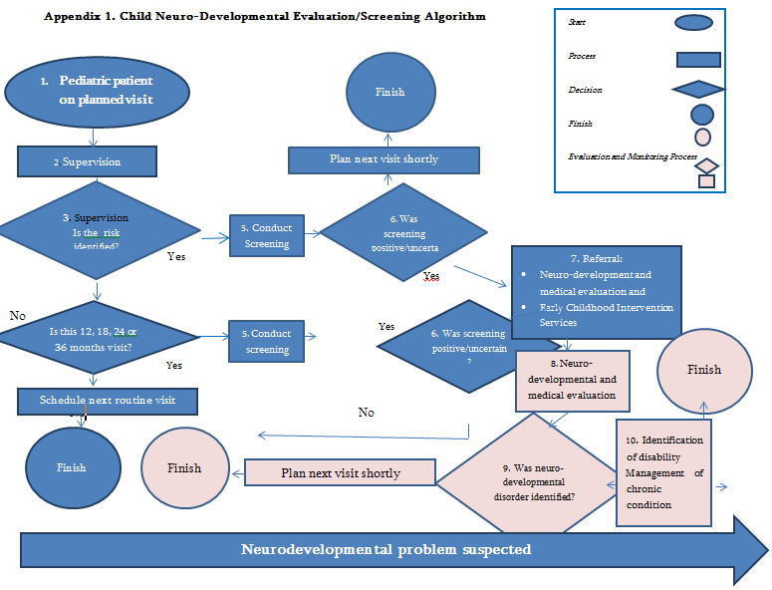
Established Neuro – Developmental screening and evaluation algorithm

Slide 44

Developmental Screening
Important: Screening instruments may be used ONLY to determine if a child should be referred for professional assessment and evaluation. Screening results may not be used to determine a child’s level of development or if the child qualifies for special education services.
Standardized Screening Tools
The Ages & Stages Questionnaires®, Third Edition (ASQ®-3) – 2 – 66 month
Ages & Stages Questionnaires®: Social-emotional, Second Edition (ASQ®:SE-2)
MCHAT – The modified checklist of Autism in Toddlers – 16 - 30 month, assessment risk of ASD
LAP (learning accomplishment Profil) – D Screens – 3,4,5 years

Slide 45
Process of identification of eligible children and referral to ECI services
Early Intervention Services
1. Screening and Identification–Primary Healthcare /Children’s Policlinics
2. Referral to the Social Service Agency
3. Evaluation of Child's Eligibility for ECI Service by State Social Workers
4. Informing family about ECI services and referral

Slide 46
Sources of Referral To ECI providers
It is important to gather data from where the referral comes from and have a collaborate with the active and potential referral sources:
State Social Service Agency – more then 50%
Maternity Hospitals - 1%
Primary Health Care Doctors – 5%
Child Neurologists from different Clinics – 10%
Neuropsychological Clinics – 5%
Self Referral (informed by other Parents, information in media) – 20%
Kindergarten – 5%
Other/unknown sources – 4%

Slide 47
To be Enrolled in the Georgian ECI state program child should meet eligibility criteria:
  Child is at risk of Developmental Delay - According to ICD – 10 - R62.9 Lack of expected normal physiological development, unspecified
  Delay in one or more developmental areas: Gross Motor, Fine Motor, Communication, Cognition (problem-solving), Social-Emotional. According to ICD – 10 - R62.9, Lack of expected normal physiological development, unspecified
  Intellectual or Physical Disability, Genetic and Chromosome Disorders, Inborn error metabolism, Neurological Disorders
  Neurobiological Disorders, Low Birth Weight, Acute Toxic conditions
  A medical doctor is making a diagnosis according to ICD-10 (International Classification of Diseases) and indicates in health condition form #100

Slide 48
Early identification and timely referral should be improved
Current need – strong system of developmental screening and referral to ECI services of children under 3 years
Lower attendance of children from 0-2 Years (20%) compared with children from 3-6 years old (80%)
Current need – Premature and Low Birth Weight children should be assessed at maternity houses, children at risk of developmental delay or disability referred to ECI services
No or late referral to ECI services
Current need – The children at high risk of developing delays or disabilities due to family or community environmental risks are left out of the ECI program.
Lack of detection tools and criteria
Only 20% of children are involved in ECI who are at risk (environmental or biological risk)
Notes:
including situations such:
- Living in severe poverty or in zones of concentrated extreme poverty that result in causing developmental delays due to environmental impact;
-Living in remote rural areas and lack of access to health and educational services;
-Living in internally displaced populations or refugee groups affected by trauma;
-Affected by domestic violence causing social and/or emotional delays;
-Having a depressed mother causing a depressed and delayed infant or child;
-Affected by child abuse or neglect that cause social and emotional delays;
-Living in prison with a parent or children of an incarcerated parent;
-Being the child of commercial sex workers

Slide 49
Risk Factors of Child Development
Child Development
Quality of Parent – Child transactions
Family - Orchestrated child experiences
Personal Characteristics of Parents
Financial Resources of the Family
Health and Safety Provided by Family
Social Support
Child Characteristics
Guralnick, M.J, PH.D. Effective Early Intervention, the developmental Systems Approach. University of Washington, Seattle, Washington

Slide 50
Best Practice
In Portugal Eligibility is made according to ICF-CY (International classification of functioning, disability,\ and health: children and youth)
Children aged 0 – 6 years old and respective families are eligible for support when they present the conditions included in the following groups:
1st Group – “Changes of body function or structure” that limit the normal development and participation in typical activities, considering the appropriate development referential to respective ages and social context;
2nd Group – “High-risk of developmental delay” due to the existence of biological, psycho-affective or environmental conditions which involve a high probability of relevant delays in child development.
Recommended practices in Early Childhood Intervention: A Guidebook for Professionals. 2019 Eurlyaid

Slide 51
Eligibility Criteria
US, Oregon:
Children with developmental delay: 2 standard deviations delayed in one or more areas of development or 1.5 standard deviations delayed in two or more areas of development.
Children with Biological risks: A child born with a diagnosed condition that is likely to result in a delay such as very low birth weight, drug and/or alcohol addiction, a genetic disorder, autism, spina bifida, etc.
Established Disability: autism, communication disorder, hearing impaired, vision impaired, orthopedically impaired, cognitively impaired, deaf and blind, traumatic brain injured, health impaired, learning disabled, emotionally disturbed.
Spain:
Any child with developmental delay (assessed by psychometric tests), with a disability, or with communication, emotional and behavioral problems either by organic or social causes.

Slide 52
Referral to ECI Services from SSA
Initial communication with families either by state Social Worker or ECI provider organization, or both:
  Information about the program characteristics, ECI specialist and family cooperation, rights, and responsibilities
  Information about the timeline of the ECI program, transition process into the educational services
  Terms and conditions of ECI voucher realization
  The signing of informed consent/contract between ECI provider organization and family

Slide 53
Group work - divide into 2 groups
Question for reflection:
How children are referred to social/special education services in Greece?
What is needed to have an effective referral system based on the Ecological model – Bio-Psycho-Social assessment
What kind of activities/tools do we have or need to conduct a bio-psycho-social assessment of a child;
How to ensure engagement of the parents in the working process right from the beginning
Working time 20 min
Presentation for each group 5 – 7 min
Notes:
Information about the program characteristics, ECI specialist and family cooperation, rights, and responsibilities – ensures families are informed about their role, participation, and sharing of responsibilities. Families can choose agree or refuse to participate in the program. Family can choose the service provider organization, if there is a need, change the service provider organization

Slide 54




European Association of Service providers
for Persons with Disabilities
Thank you!

