Slide 1


Technical Support to implement reforms to support the development of family centred early childhood intervention services in Greece - ECI Greece
Grant Agreement n° 101048313
PPT 5: Early developmental therapeutic intervention

Slide 2



Table of Contents
The development of the child
Which children need developmental therapeutic intervention?
Therapeutic intervention yes: Why early?

Slide 3
Chapter 1
The development of the child

Slide 4

Life is characterized by 3 key moments:
Conception – Birth – Death
And 2 periods:
Prenatal period – Postnatal period

Slide 5
From conception to birth

Slide 6


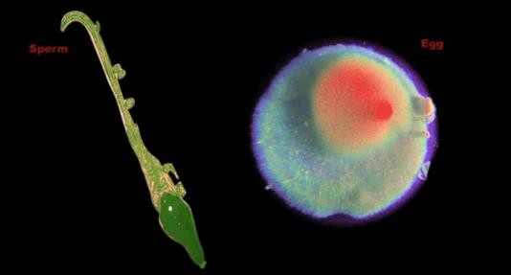
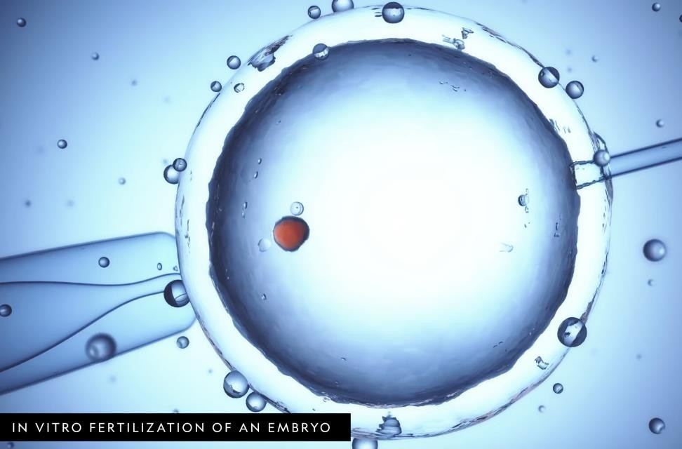


Slide 7


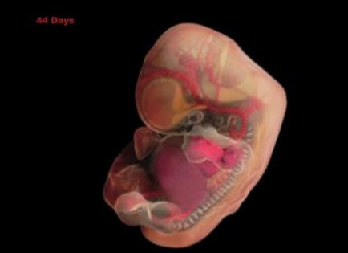
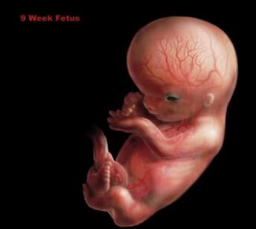

Slide 8
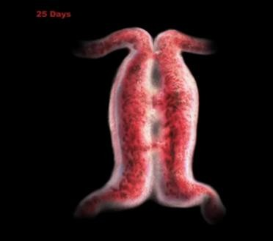
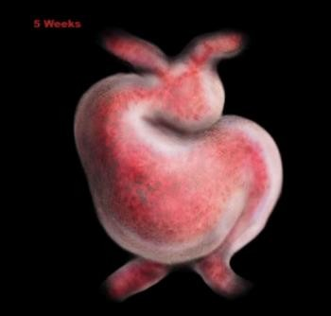
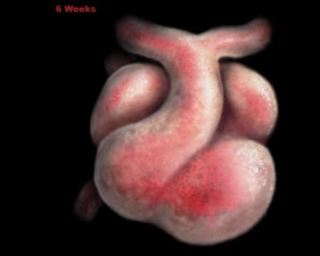
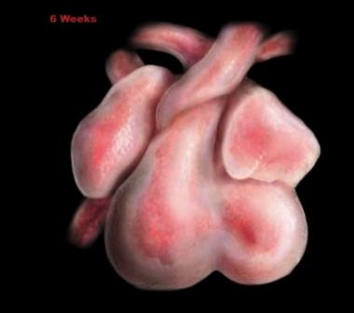


Heart development

Slide 9
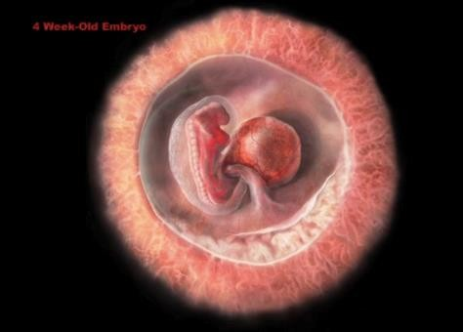
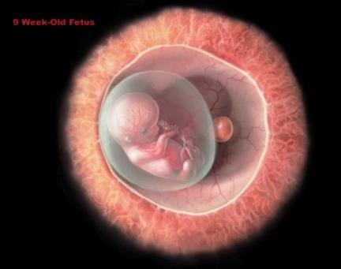
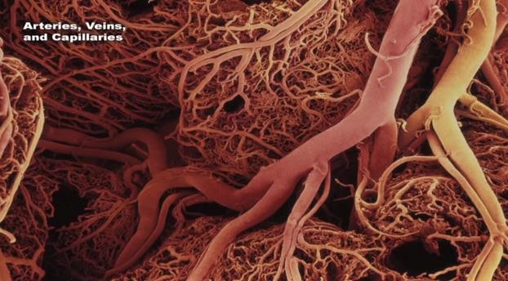
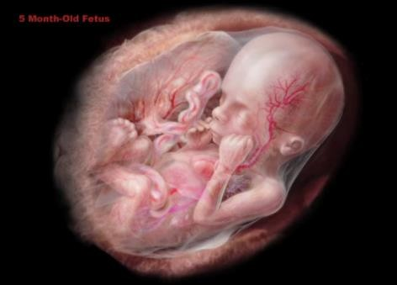
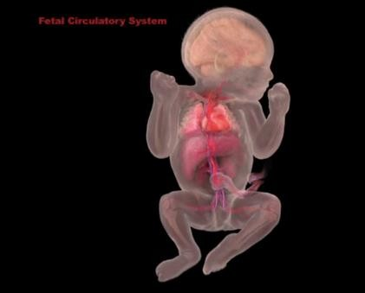
Vascular development

Slide 10
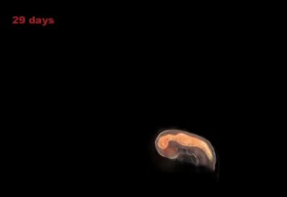
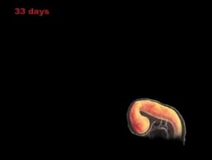
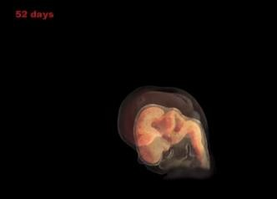
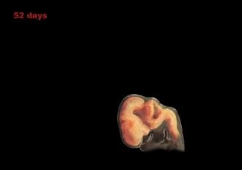
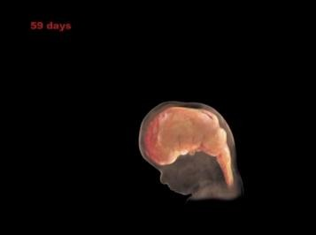
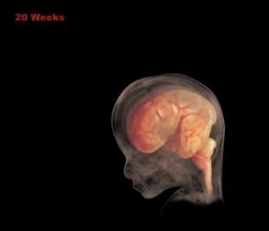
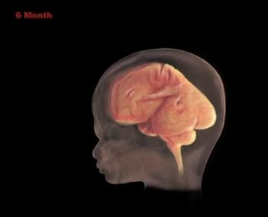
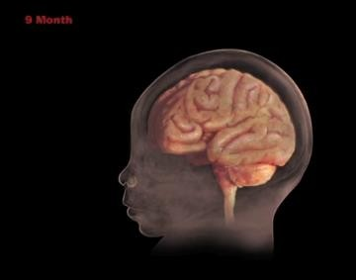
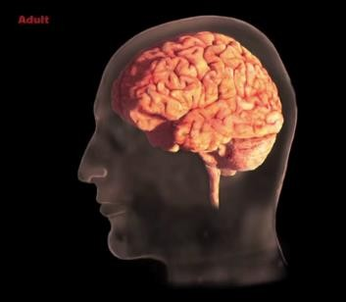
Brain development

Slide 11
Functional Development of the Fetus

Slide 12
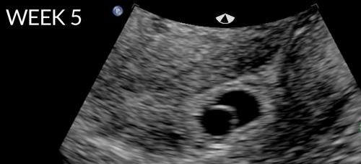
Seed Size
The heart beats
The brain grows
with 100,000 cells per minute
1 million cells per second

Slide 13
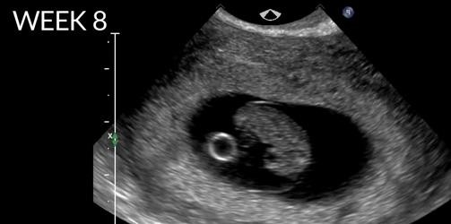
Berry Size

Slide 14
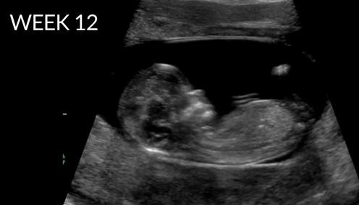
Lemon Size
Reaction to stimuli:
Smell
Hearing
Hand / finger movements
Smile
Thumb-sucking

Slide 15
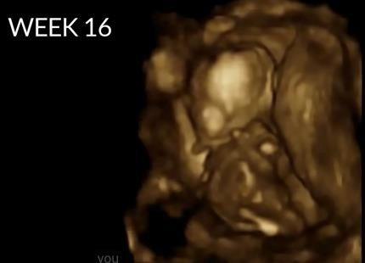
Large Tomato Size
The head is equal to the body
Kicks
Swallows
Urinates
Tastes

Slide 16

Quince Size
Hears Better
Teeth appear
Hair
Nails
Brows
Eyelashes
Rotates
Kicks
Learns the action-reaction relationship

Slide 17

Cauliflower Size
Cerebral cortex splits into 2 hemispheres
Eyes open
Responds to light
Simple facial expressions (smile?)

Slide 18
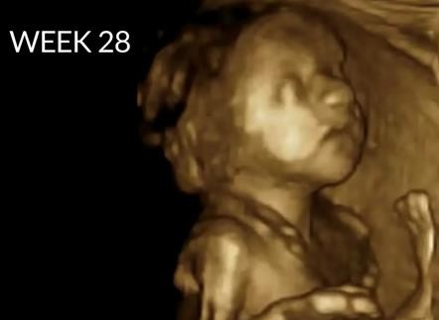
Pineapple Size
Regular sleep /wake intervals
Response to mom's voice
Response to external noises
Movement
90% chance of survival in the event of pre-term birth

Slide 19


Melon Size
Behaviour of newborn
Nervous system ready
Breathing exercise (amniotic fluid)
Sleeps a lot
Changes position
Flexible bones
Immature immune system

Slide 20
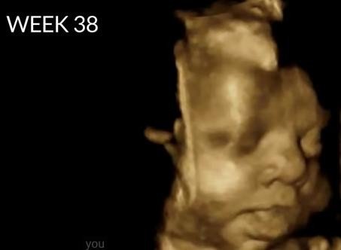

Kicks and moves
Stronger immune system
Reacts to sensory stimuli

Slide 21


The prenatal period is extremely important for the child’s future
Events such as:
Genetic mutations
Chromosomal abnormalities
Toxic – teratogenic agents
Difficulties in pregnancy
Stress
80% of developmental disorders

Slide 22
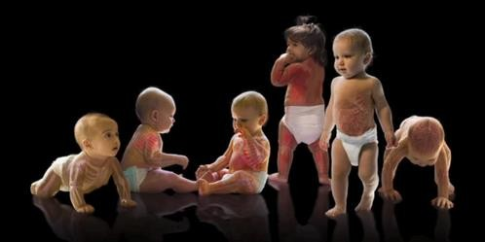
Life after Birth

Slide 23
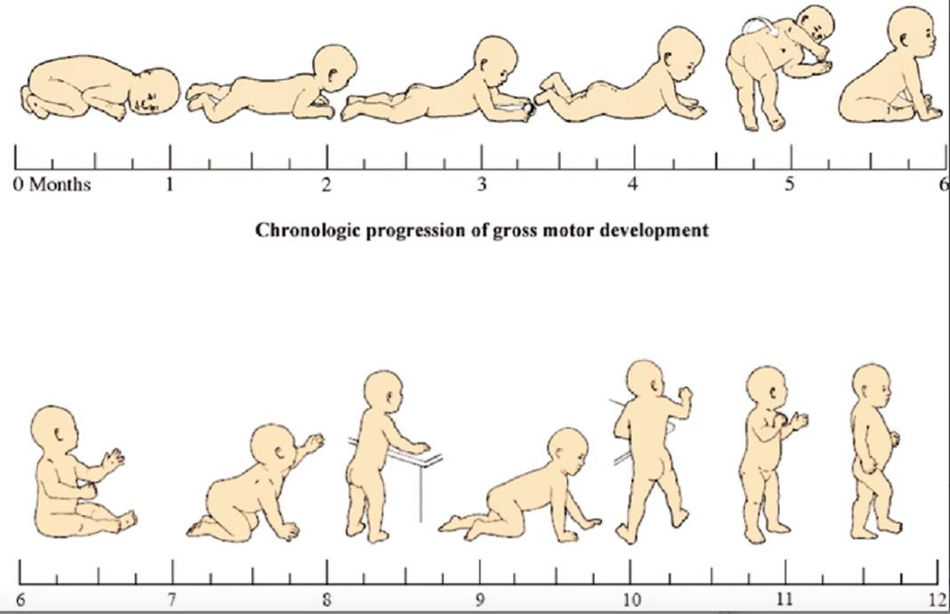
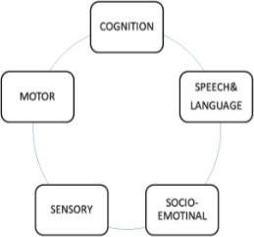

Slide 24


1 month

Slide 25


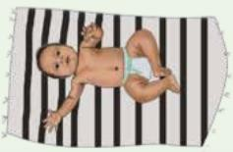
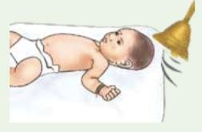
2-3 months

Slide 26
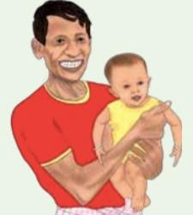
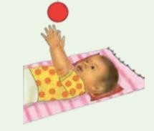
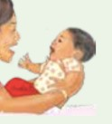
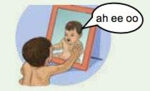
4-6 months

Slide 27
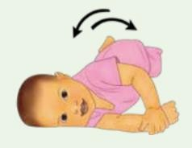
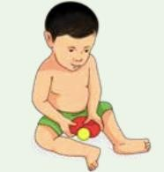
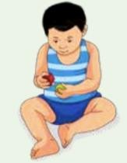
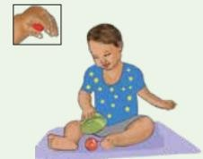
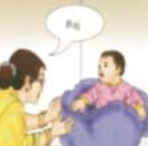
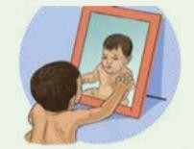
7-9 months

Slide 28
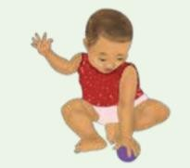

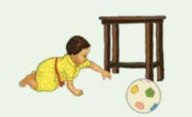

10-12 months

Slide 29
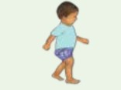
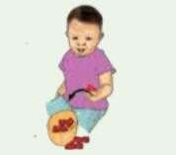


18 months

Slide 30
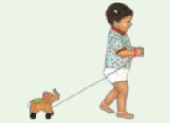
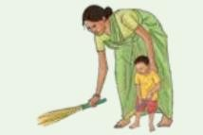
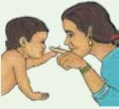
24 months

Slide 31


3 years

Slide 32






“Nature”
Intrinsic factors
The development of the child is the result of neural function
“Upbringing”
External factors
Environmental
Genetic
NEURODEVELOPMENT

Slide 33


Epigenetics
Children's experiences actually influence gene expression

Slide 34
So what should we remember about children's development?

Slide 35
Development is a highly interactive and sensitive process that is not exclusively determined by genes.

Slide 36

The architecture of the brain for the most part is formed in the period from conception to the first three years after birth.

Slide 37

Even infants and young children are affected when there are chronic stress conditions in the environment where they grow up.

Slide 38

The close relationship with the parents is extremely important, even before childbirth.

Slide 39

Severe neglect of a baby / child is as great a threat to health and development as physical abuse.
Source: Perry, B.D. (2002). Childhood experience and the expression of genetic potential: What childhood neglect tells us about nature and nurture. Brain and Mind 3: 79-100. Reproduced with permission of the author.

Slide 40
Who are the children in need of early developmental therapeutic intervention?

Slide 41


Developmental disorders

Slide 42

Disorder | Severe impact | Mild impact
Mental | Intellectual disability | Borderline cognition Slow learning
Motor | Cerebral damage | Mild hypotonia Ataxia Mild neurological signs
Verbal | Aphasia Autistic spectrum | Developmental verbal disorders
Sensory / Perceptual | Dyslexia Deafness Blindness | Learning difficulties Hearing loss Low vision
Electrical | Epilepsy | EEG abnormalities without convulsions
Morphological | Malformations Chromosomal disorders Genetic syndrome | Dysmorphic features Microcephaly

Slide 43


Slide 44




2-3 months
Red flags
The child does not pay attention to your face, the child does not smile at the sound of the carer’s voice
The child cannot support its own head
The child has strabismus, eye goes outwards

Slide 45





4-6 months
Red flags
The child cannot support its own head or torso
The child has no interest in playing with toys and games (especially new toys)
The child does not interact with their carer, shows no affection for the person that cares for them
The child does not push down with their legs when feet are placed on a hard surface

Slide 46





7-9 months
Red flags
The child kinetically, perceptually and communicatively does not progress
The child does not reach to grab things
The child does not sit without help
The child does not respond to their own name

Slide 47

10-12 months
Red flags
The child does not crawl, does not reach out to parents
The child cannot sit by itself

Slide 48



18 months
Red flags
The child cannot walk
The child doesn’t point to show things
As the child continues to grow, there is a greater divergence from typical development

Slide 49


24 months
Red flags
The child cannot follow simple instructions
The child cannot copy actions or words
The child does not walk steadily

Slide 50




3 years
Red flags
The child falls down a lot or has trouble with stairs
The child does not want to play with other children
The child cannot work simple toys
The child cannot answer simple questions

Slide 51


Why early developmental intervention?

Slide 52





Brain development
Then pruning, so that the brain circuits become more efficient

Slide 53


Each brain function has its own critical development time.
Source: Nelson, C. (2000). Source: Center on the Developing Child at Harvard University. Core concepts in the science of early childhood development. http://developingchild.harvard.edu. Reproduced with permission of the author.
Source: Levitt, P. (2009). Source: Center on the Developing Child at Harvard University. Core concepts in the science of early childhood development. http://www.developingchild.harvard.edu. Reproduced with permission of the author.

Slide 54



Neuroplasticity
In the first years of life, more than 1 million new neural connections are formed every second
“Práticas Recomendadas em Intervenção Precoce na Infância: Um Guia para Profissionais”, 2015

Slide 55
What we should remember about the value of early development intervention?

Slide 56

The early provision of appropriate therapeutic approaches yields very good results

Slide 57

Neuroplasticity of the developing brain
in the early years of life is characterized mainly by:
Easy synapse formation
Easy change of existing synapses
Non-consolidation of neural circuits

Slide 58

Late intervention to build new skills requires more effort.

Slide 59
Early experiences affect the
developing brain
as early as in the prenatal period

Slide 60
Chronic stress can be toxic to the developing brain

Slide 61

Early brain damage can lead to lifelong problems

Slide 62
Early developmental therapeutic intervention further prevents
adverse effects

Slide 63
Stable care relationships with parents and caregivers are essential for healthy
development

Slide 64


Children need opportunities, motivation, play and simple everyday routines to learn.
Rethinking Early Childhood Intervention Services: Implications for policy and practice, Tim Moore, 2012
American Academy of Pediatrics, 2013
Children with developmental disorders learn in the same way as other children.

Slide 65





European Association of Service providers
for Persons with Disabilities
THANK YOU

