Slide 1


Technical Support to implement reforms to support the development of family centred early childhood intervention services in Greece - ECI Greece
Grant Agreement n° 101048313
PPT 4: Early Childhood Intervention: Framework, Guiding Principles and Practices -
Towards a Paradigm Shift

Slide 2


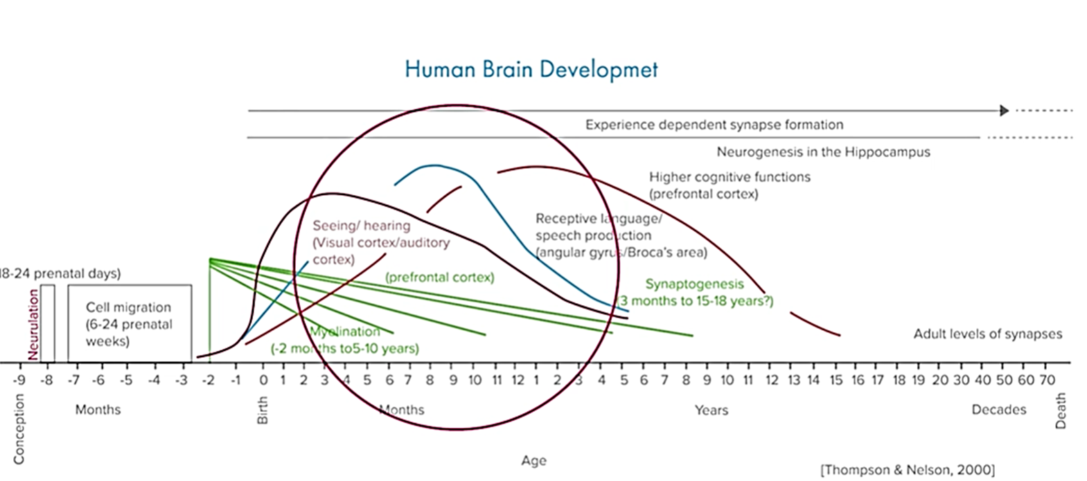

Scientific Data / Neurodevelopment
200,000,000 children globally fail to reach their development potential in the first 5 years of their life.

Slide 3

Neuroplasticity
Neuroplasticity has to do with the ability of the nervous system to change itself through experience at cellular, metabolic or anatomical level.

Slide 4
Neuroplasticity - the appropriate timing
This ability varies over time and it is known that the younger the child the greater the ability of the nervous system to change.
Νelson, 2000

Slide 5

Neuroplasticity
& Early Childhood Intervention
The basis of the Early Childhood Intervention concept
Neuroplasticity

Slide 6
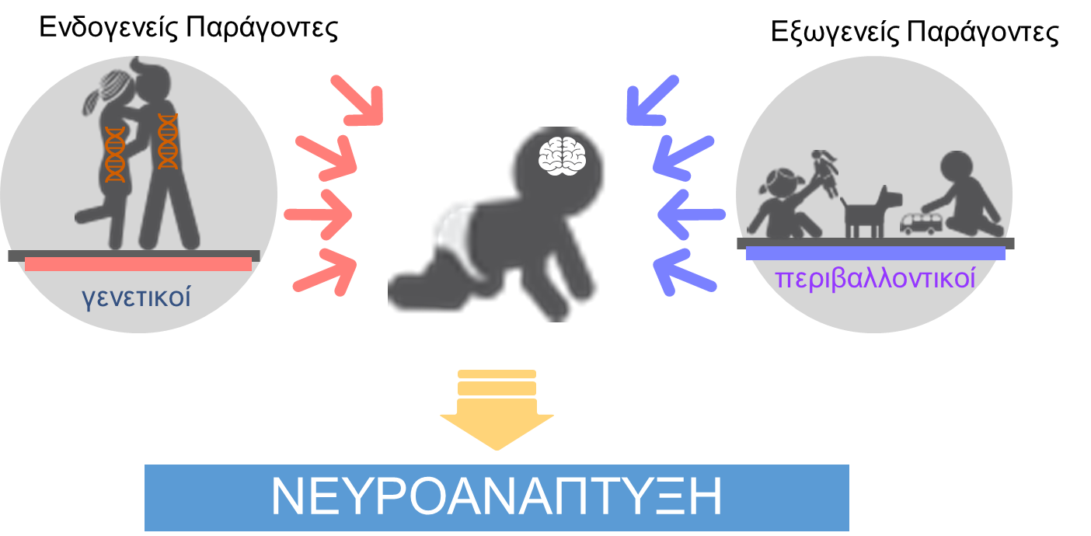

Neurodevelopment
Intrinsic factors
Extrinsic factors
genetic
environmental
NEURODEVELOPMENT

Slide 7



Neurodevelopment – the appropriate environment

Slide 8
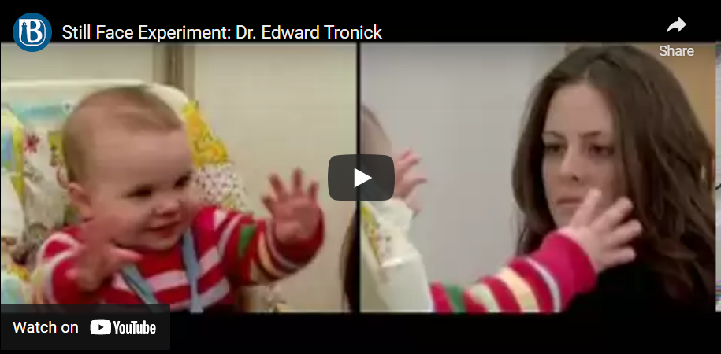
Neurodevelopment &
Early Childhood Intervention
The Still Face Experiment
Notes:
https://developingchild.harvard.edu/resources/three-core-concepts-in-early-development/

Slide 9

Neurodevelopment & ECI
A poor environment is associated with other risk or neurodevelopmental pathology factors and creates the conditions for further disorders

Slide 10
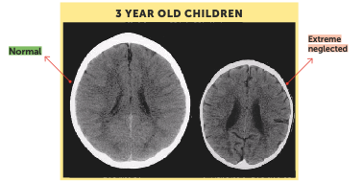

Neurodevelopment
& ECI
Effects of severe child neglect on
the development of the brain
Source: Perry, B.D. (2002). Childhood experience and the expression of genetic potential: What childhood neglect tells us about nature and nurture. Brain and Mind 3: 79-100. Reproduced with permission of the author.

Slide 11
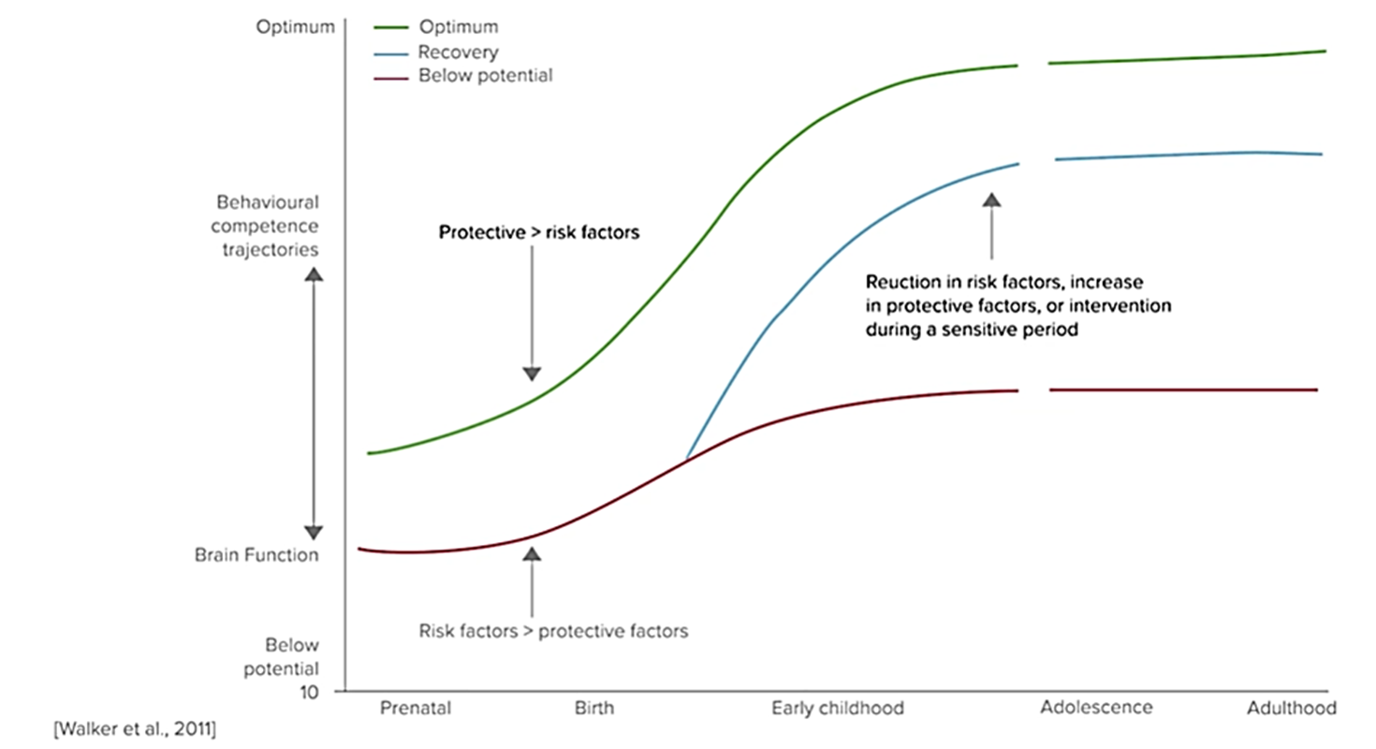
The ecological development model

Slide 12

Neurodevelopment & ECI
All the neurobiological data support the impact of the environment on the development and maturation of the Central Nervous System and consider ECI responsible to improve the natural environment of the child.

Slide 13
ECI for children with disability or developmental delay
Early Childhood Intervention (ECI) provides specialised support and services for infants and young children with disability or development delay and their families to help their development, well-being and participation in family and community life.
The aim of ECI is to ensure that parents and other important adults in the child’s life can provide young children with disability and/or developmental delay with experiences and opportunities that help them gain and use the skills they need to participate meaningfully in their everyday lives.
Early Childhood Intervention Australia (ECIA), 2016 www.ecia.org.au

Slide 14
Necessary conditions for development & Early Childhood Intervention
LEARNING ENVIRONMENT
ROLES OF RELATIONS
DEVELOPMENT ENVIRONMENT
EARLY CHILDHOOD INTERVENTION

Slide 15
Recommended practices in early childhood intervention
Evidenced-based recommended practices apply qualitative indicators and are implemented by internationally recognised organisations
Coordination and integration of services and resources
Family-centered routine-based interventions
Teamwork, preferably transdisciplinary
Interventions in natural learning environment

Slide 16

Learning & Development

Slide 17
Development & Early Childhood Intervention
The concept of important adult/carer
Learning in natural environments
Learning in early childhood
Routine-based learning throughout the year
How children learn and develop

Slide 18


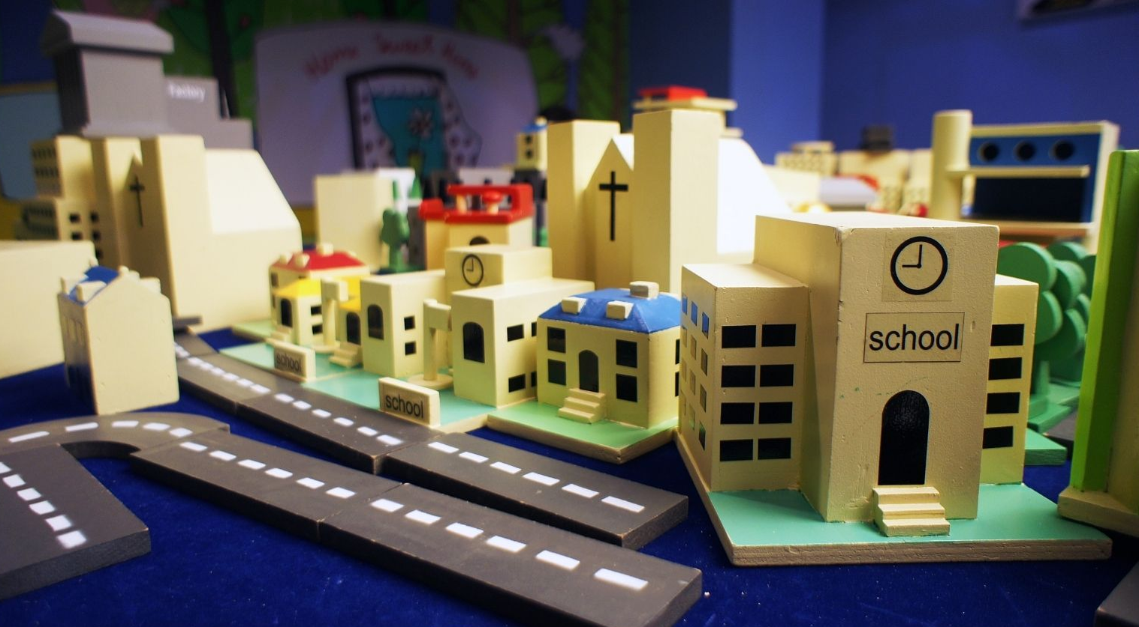
Learning & Development
DAILY ROUTINES
THERARY
VS

Slide 19

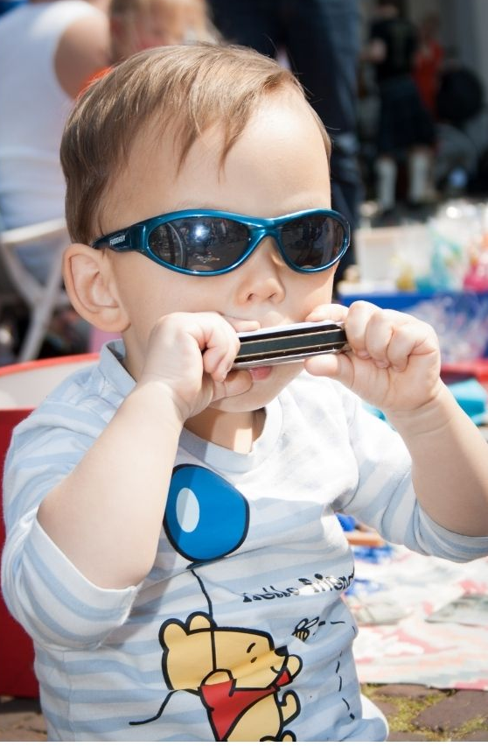


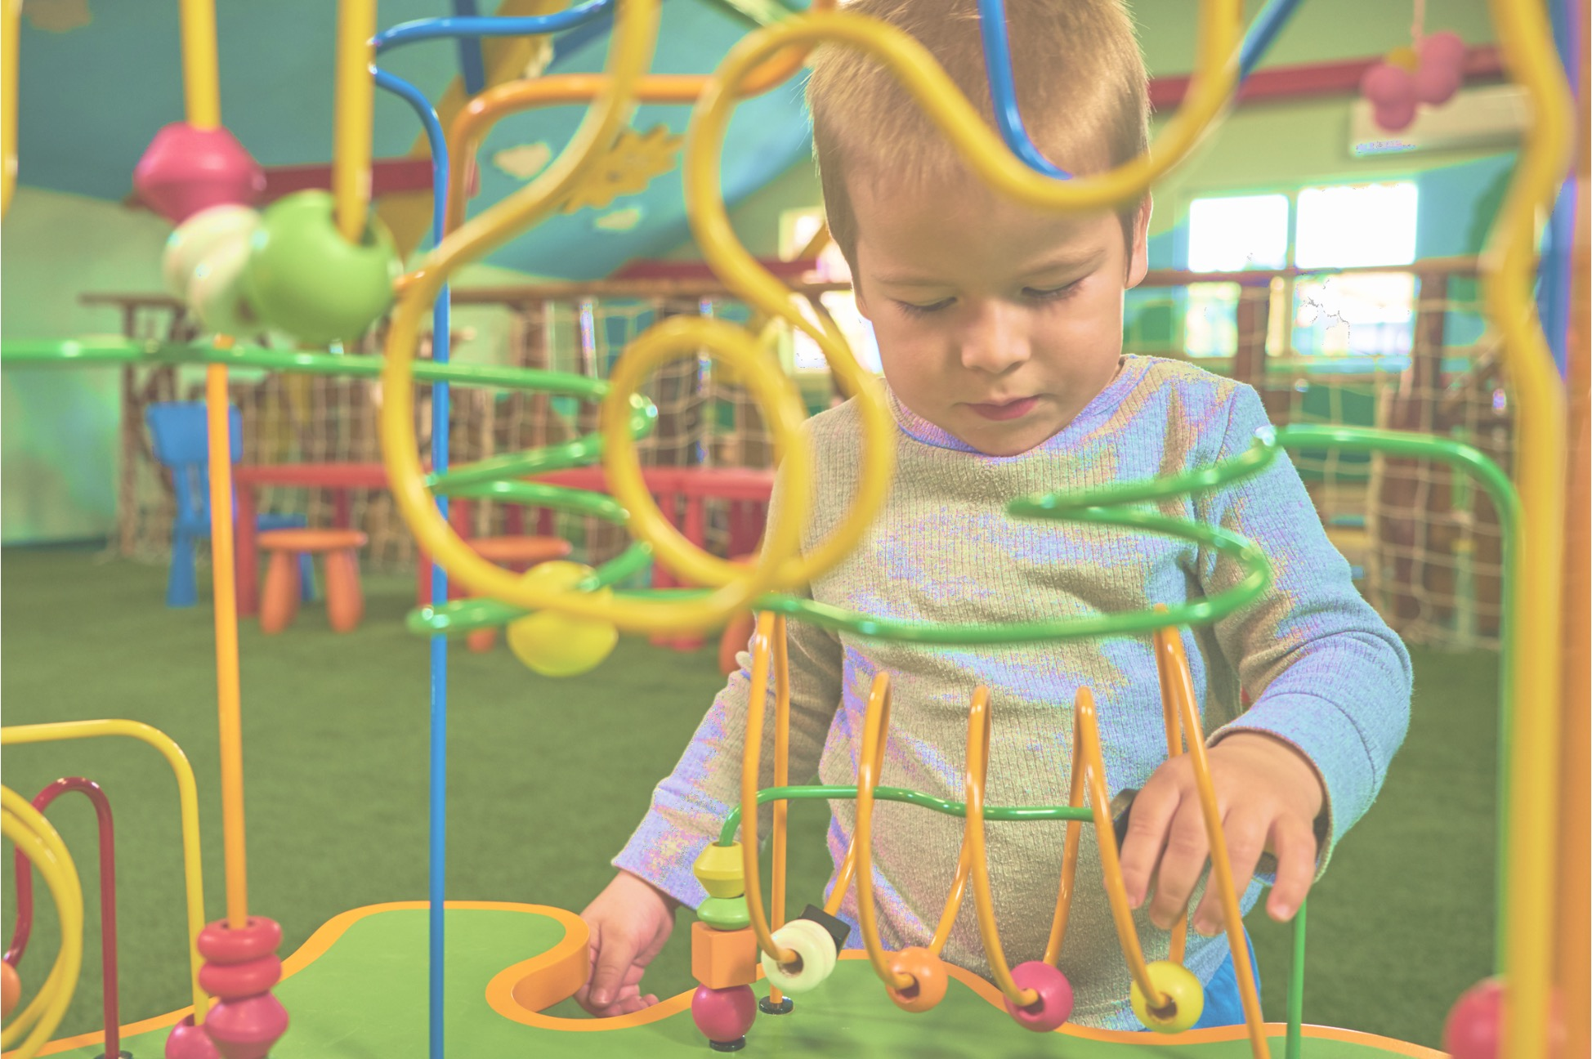
Development & ECI

Slide 20





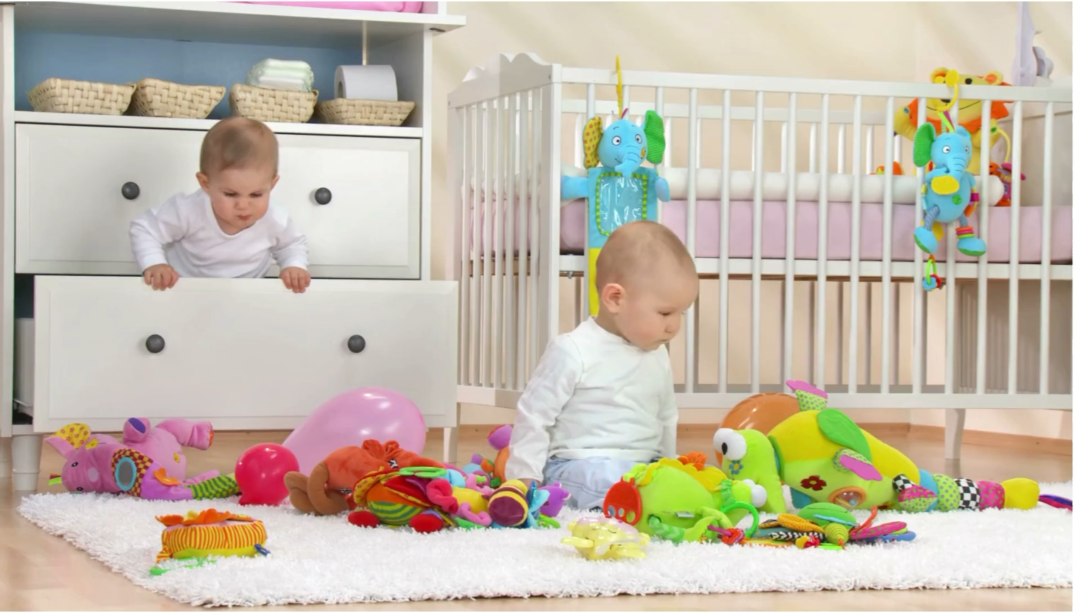
Development & ECI

Slide 21
How children with disability learn & develop
More observing parents
Access to opportunities
Additional help and Specialisation
Key relations (nature and quality of relationship)
Secure connections (responsive and caring)

Slide 22
FAMILY-CENTERED PRACTICE Carl Dunst
Learning opportunities of children
Family and community resources
Parent support

Slide 23
Family-Centred Approach
Who has the highest impact on child development?
Parents
Special education teachers
Source: Mahoney, G. & MacDonald, J. (2007) Autism and developmental delays in young children: The Responsive Teaching curriculum for parents and professionals. Austin, TX: PRO-ED. Back-translation from Greek into English
Therapists

Slide 24
Family-Centred Approach
The family is responsible for the child throughout his/her family
The family impact on child development and learning
The power of the family in child development
What for?

Slide 25
Family-Centred Approach
Intervention based on the strengths of the child and the family
Promotion of the adequacy and self-confidence of carers
Promotion of the sense of competence and empowerment of the families
Capacity-building and empowerment aiming the autonomy of families will be the ultimate goal
Working with the family

Slide 26
Family-Centred Approach
The family-centered approach is not dependent on the intervention framework or the area of activity
Intervention in the natural learning contexts of the child and the family
The intervention is built on the strengths of the child and the family
Intervention based on the routines of the child and the family
Intervention based on community resources
Source: Dunst, Johanson, trivette, Hamby/1991

Slide 27

Family-Centred Approach
“ It takes a whole village to raise a child”
Source: Dunst, Johanson, trivette, Hamby/1991

Slide 28
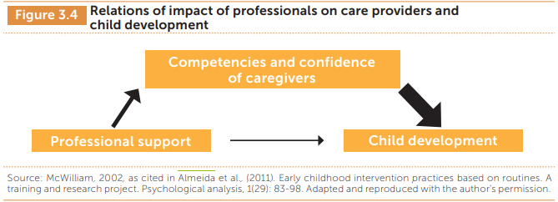
Family-Centred Approach
THE BASIS

Slide 29
Family-Centred Practice
…a set of principles that determine not only what happens but also how
WHAT: mobilisation of formal and informal resources to support the family
HOW: “how” support is provided is as important, if not more, as “what” is done.
-- Dunst, Trivette & Deal, 1994; Trivette & Dunst, 2000

Slide 30
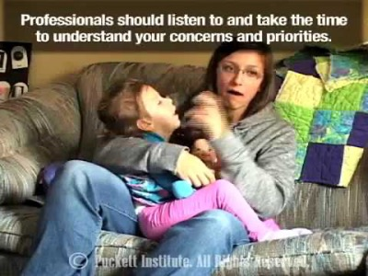
Family-Centred Approach
HOW?

Slide 31
Family-Centred Approach
Individualised practice for every family
Families and professionals work together like partners
Response to the priorities and objectives of the families
The entire family is the intervention unit
Professionals are agents at the service the family
WHAT CHANGES?

Slide 32
Family-Centred Approach
Relational Practices (development of relations)
Participatory Practices
(Capacity building)
-- Dunst, Boyd, Trivette & Hamby, 2002; Dunst & Espe-Sherwindt, 2016

Slide 33
Components of effective assistance
-- ANIP /IM2 (adapted from Dunst, 1998, 2000, 2002); Espe-Sherwindt, 2008
Active listening
Empathy
Authenticity
Reliability
Honesty
Understanding and Respect
Sincere Interest
Trust in its capabilities
Education
Professional experience
Specialisation
Knowledge of developmental pathologies
Knowledge of using assessment tools
Knowledge of evidenced-based and recommended practices
Relational Practices
Quality of vocational training
Encourage families to use their knowledge and capabilities
Help the family to acquire new capabilities
Share information with the family
Encourage parents to make their own decisions
Participatory Practices

Slide 34
Family-Centred Approach
It is not enough to work with the family to be family-centered
Type of approach | Typical assumptions about the family | Typical assumptions about professionals and intervention
Family-centered | Families are viewed as fully capable of making informed decisions and acting on their choices. | The professional is viewed as the agent and tool of families. His role is to provide the necessary information to the family so that she can make informed decisions and create opportunities to strengthen their competencies. The intervention focuses on the promotion of competencies and the mobilization of resources and support to the family, in an individualized, flexible and responsive way.
Family-focused | Families are seen as capable of making choices, but options are limited to the resources, support and services that the professional deems to be best suited to the family needs; the family is seen as services consumer. | The professional supports and advises the family on how interventions should be performed, monitoring how the family uses the services provided by the professional.
Family-allied | Families are seen as minimally capable of effecting changes in their lives but are seen as the agent of professionals. | The professional establishes the interactions deemed important and necessary for the family and the family is supposed to implement and develop the prescribed interventions.
Professional-focused | Families are seen as deficit or pathological. Families are passive participants in the process, and there is little or no consideration for their opinions and views. | The professional is viewed as the expert who determines family needs and implements the interventions. A “paternalistic” model similar to the medical model.
Source: Dunst, Johanson, trivette, Hamby/1991

Slide 35
Family-Centred Approach Guidelines
Carl Dunst
TEN PRINCIPLES IN THE FAMILY-CENTERED PRACTICE
Families and family members are treated with dignity and respect at all times
Professionals are sensitive and responsive to family cultural, ethnic and socio-economic diversity
Family choice and decision-making occurs at all levels of family involvement in the intervention process
Professionals share the information that the families need to make informed choices
The focus of intervention practice is based on family-identified desires, priorities and needs

Slide 36
Family-Centred Approach Guidelines
Carl Dunst
TEN PRINCIPLES IN THE FAMILY-CENTERED PRACTICE
Support, resources and services are provided in a sensitive, responsive and individualized manner
A wide range of informal, community and formal supports and resources are used for achieving family identified outcomes
Professionals build on strong points, the child’s skills and interests, as well as those of the parents and the family as the main paths to strengthen the family functions
Professional-family relationships are characterized by partnerships and collaboration based on mutual trust, respect, and problem solving
Professionals use help-giving practices which support and strengthen family functioning
Notes:
It is a concept and focuses primarily on HOW we action rather than on the action itself

Slide 37
Family-Centred Approach Guidelines
Adopting a family-centred approach which places the family on the focus of the intervention entails a
FUNDAMENTAL CHANGE
in the way we perceive of help-giving services for children with disability
CHANGE
in the way the professional perceives of their role but also in the beliefs for families

Slide 38
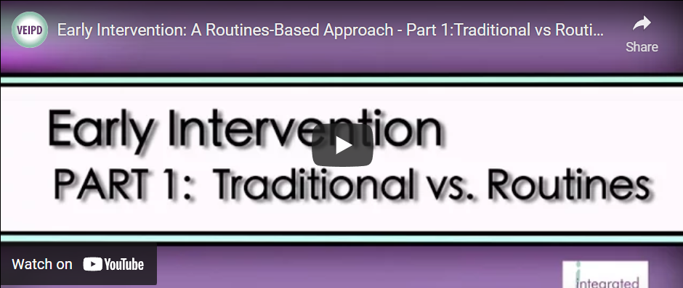
Family-Centred are Successful
-- Dunst, Bruder & Espe-Sherwindt, 2014, p. 43

Slide 39

Child with Disability: The turning point
Reorganisation Level
Faced with disability:
The News
OPPORTUNITY
ECI
Reorganisation Level
RISK
Disorganisation period
Imbalance
-- Reuben Hill, Families Under Stress, cited in On This Journey Together

Slide 40
Family-Centred Approach for Children with Disability: The Challenges
Determine what strategies and experiences will be effective for the specific child and family
ESPECIALLY FOR CHILDREN WITH DISABILITY who have the same relational needs but need to develop special techniques, adaptations and contexts to establish relations
Identify and bring to the fore the disability-related stress factors, the need for knowledge of the child’s special health condition and for additional resources

Slide 41

Family-Centred Approach for Children with Disability: The Challenges
Technical knowledge and skills
Their personality qualities
Special techniques to support the family
Collaboration and teamwork capability
Available resources

Slide 42

Early Childhood Intervention = RELATIONSHIPS

Slide 43

Early Childhood Intervention = RELATIONSHIPS
The Early Childhood Intervention is Relationship-based
Between parents, family members, carers and the child
Between the family and the Community
Between the family and the ECI professionals
Among professionals themselves
The quality these relationships and collaboration affects and outcomes and success of Early Childhood Intervention
-- Raver & Childress, 2015

Slide 44
Relations with the Family:
Family-centred Framework
Relations among professionals:
Working together as a Team
-- Raver & Childress, 2015
Notes:
The family-centered approach requires the family to be a partner in the intervention process

Slide 45

Family-Centred Approach
Working as a TEAM

Slide 46

What is a TEAM?
Placing people together in a room does not make them a Team!

Slide 47
Training Programs and services for children who are at risk of or have developmental delay or disability always involve by default several adults.
The quality of relationships and interactions among these adults impacts the success rate of these programs and services.
Team collaboration should be such as to promote and maintain a collaborative and ongoing relationship between these adults so as to achieve the appropriate outcomes for children
Division for Early Childhood. (2014). DEC recommended practices in early intervention/early
childhood special education 2014. Retrieved from http://www.dec-sped.org/recommendedpractices

Slide 48

Key Terms
Interdependence
Direct interaction
Complementary
skills
Accountability
Mutual
commitment
Shared prospects
Shared goal
Clear Roles
Common Goals

Slide 49

Remember!!
The Family is a member of the TEAM
Every family has:
  unique knowledge/perspective
  skills that are complementary to those of
  the professional
  the role of the child's parent who ultimately
  takes the decisions

Slide 50
3 ECI Teamwork Models
Most programs use one of these teamwork options:
Multidisciplinary
  Professionals from different specialties work independently with few opportunities for cooperation and communication
Interdisciplinary
  Professionals from different specialties actually perform assessments separately, share information, can plan together, but provide the intervention on the basis of their own specialty
  Transdisciplinary
  Professionals make every effort to work continuously together rather than in isolation.
-- Raver & Childress, 2015

Slide 51

Which model does the structure of your team resemble?
What is the role of the family in each of the above cases?

Slide 52
Transdisciplinary Team
The transdisciplinary model consists of a team of professionals from different disciplines, characterised by sharing and exchanging knowledge and competences among its members, thus developing a common language and mutual trust. The boundaries between disciplines become increasingly blurred, thus promoting consensus among team members –including the family as a partner and the key decision-maker in the evaluation and intervention process (Carvalho, 2004). In addition, this model argues that the family is an integral part of the ECI team and should, therefore, be valued and respected, like any other team member.

Slide 53
Transdisciplinary Team/Key Principles
Intervention with children takes place in the time between the visits of the professionals and is provided by their important caregivers.
Young children are not able to transfer skills from a learning context to their daily lives. They learn through ongoing interactions with their natural environment over time rather than in isolated lessons or sessions.
It is the children’s caregivers who contribute mostly to the promotion of the child’s development and should, therefore, embrace the intervention goals as if they are their own.
(McWilliam, 2003b)

Slide 54
Transdisciplinary Team/Primary Service Provider
In this model, one of the professionals is selected by the team to be in regular contact with the family and represent all team members. This member is called the Case Mediator (CM) and
is responsible for the implementation of the intervention plan;
mediates between the family and the team, as well as other services.
coordinates the services and resources that meet the family-identified needs of the child and the family (Almeida, 2009).
is responsible to do most of the visits to the family context or other to consult the family about specific needs requiring more specialized support.
is responsible for the implementation of the intervention plan with the family - the rest of the team provides secondary support.

Slide 55
Transdisciplinary Team/Primary Service Provider
With this teamwork modality, based on the figure of the CM, the unification of the knowledge that the team has about the child and the family is assured (Glennen & DeCoste, 1997). The fact that it is, preferably, only one professional who takes on the regular contact with the family on behalf of the whole ECI team, makes the intervention less “intrusive” for the family, who can establish easier a relationship of trust and complicity with the professional who mediates the relationship with the ECI services. In fact, data from the National Survey of Service Coordination in Early Intervention refers that 96% of parents that relate to a single professional consider it useful, while this percentage drops to 77% and 69% when parents relate to two or three professionals, respectively (Dunst & Bruder, 2004, as cited in Almeida, 2009).

Slide 56

Advantages of the transdisciplinary model
⬇ intrusiveness and stress for the family
⬇ confusion for the family
⬇ Fragmentation of services into organisations or development sectors
⬆ More coherent intervention plans and a holistic approach
Effectiveness and good cost effectiveness
Knowledge and skills for everyone including the family

Slide 57

Challenges of transdisciplinary model
Different expectations for the role and purpose of the team and members
Fear of each member losing their professional identity
Ineffective communication strategies
Reluctance to share knowledge and skills
Lack of confidence in the skills of other members
Resistance to learning new skills

Slide 58
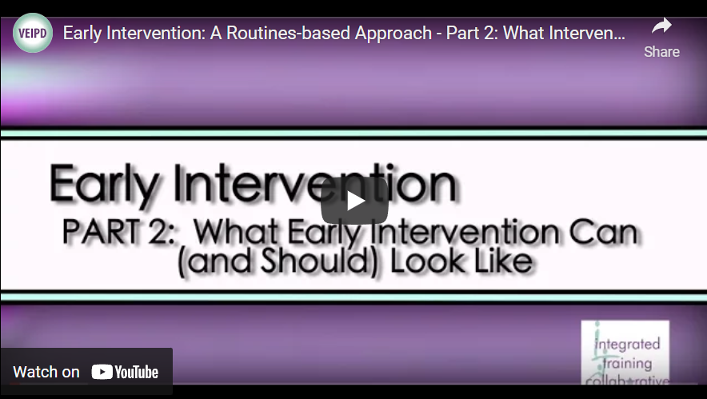
The paradigm SHIFT

Slide 59
The paradigm SHIFT- The case of Portugal
 | Before | Now
Target Population | Children aged 0 -3 years with disability | Children aged 0-6 years with developmental disorders and/or at risk and their families
Context | Stimulation Centres Therapeutic Centres Institutions | Natural contexts (home, nursery, kindergarten, etc.)
Practices | “Ready-to-wear” | “Tailor-made” Individualised
Role of professionals and families | Experts/decision makers = Passive service recipients | Facilitators = Active participants / decision-makers
Goals / outcomes | Child Development | Prevention Child Development Empowerment/family capacity-building
Teamwork | Multidisciplinary | Transdisciplinary (including the family)
Organisational structure | Sectoral (with occasional links among sectors) Fragmented Services | Intersectoral Community-based Integrated services
ECI Philosophy | Child centred Based on “deficits” | Family-centered Based on strengths

Slide 60
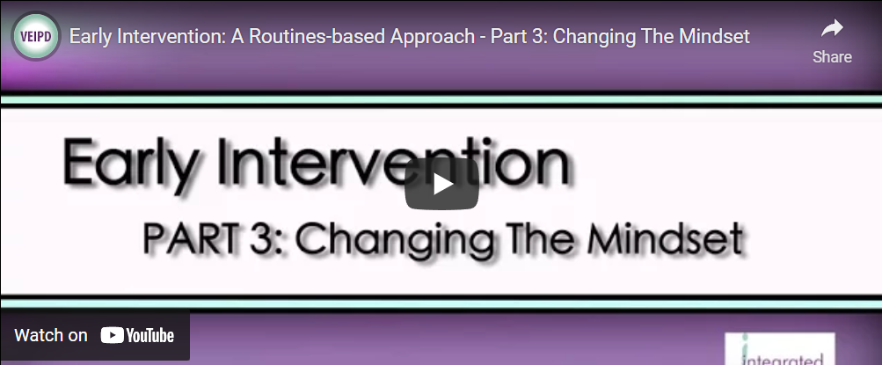
The paradigm SHIFT - THE CHALLENGES
Notes:
Challenge 2: Key worker and transdisciplinary service models. A related issue concerns the role of individual specialists in transdisciplinary teamwork: if ECI teams adopt key worker or transdisciplinary models, what is the role of the ECI specialists when they are not the key worker? To some professionals, working indirectly through a key worker or primary support team member feels like an abrogation of their responsibilities. However, from the perspective of the families themselves, the delivery of support through a key worker can be a way of making the task of meeting their child’s needs much more manageable, making it more likely that they will be able to provide the child with the kinds of learning opportunities and experiences they need. Challenge 3: Centre-based group programs. Another challenge concerns the practice of running centre-based programs for groups of children with disabilities and their parents. As with individual therapy, the question is how this general strategy achieves the overall outcomes being sought. This is an open question: if centrebased group programs can be shown to be an efficient and effective way of ensuring that children everyday learning environments are optimally supportive and inclusive, then they will continue to have a role to play. Analysing exactly how such group programs ‘work’ is a task that still needs to be tackled.
There is no doubt that the outcomes-based framework presented in this paper has profound implications for ECI practice and presents considerable challenges for traditionally-trained ECI professionals. Some professionals may experience these challenges as threatening their professional identity and skills, while others will interpret the framework as providing exciting new ways of using their skills to better effect. What should be clear is that the framework does not imply that there is no need for the professional skills of the various specialist disciplines that work in ECI services. On the contrary, these skills are needed just as much as ever. However, what is implied is that the ways in which these skills and knowledge are deployed will differ from some of the more traditional ways in which ECI services have operated.

Slide 61




European Association of Service providers
for Persons with Disabilities
Thank you!

